Slide 1

2023 Sheltered & Unsheltered Point-in-Time (PIT) Count Surveyor Training
Notes:
Read from Zoom Script

Slide 2


Presenter
Shawn Hayes
BoS CoC Coordinator

Slide 3
Table of Contents
Slide 4: Map of the BoS CoC
Slides 5 - 8: Intro to the Point-in-Time Count and Sheltered and Unsheltered Definitions
Slides 9 - 16: Homelessness Definitions and Information
Slides 17-18: Covid Safety and Health Precautions
Slide 19: Connection to Other Services
Slide 20: Privacy, Security, & Safety
Slide 21: Survey Instructions & Script
Slide 22: Homeless Management Information System
Slides 23 - 53: Review of Sheltered and Unsheltered Point-in-Time Surveys
Slide 54: Electronic Sheltered and Unsheltered PIT Surveys
Slide 55-56: Observational Counts
Slide 57: Rapid Rehousing and Permanent Supportive Housing Counts
Slides 58 - 67: Youth Count and Youth Supplemental Survey
Slide 68: Survey Collection
Slide 69 - 73: Contact info and Q&A

Slide 4
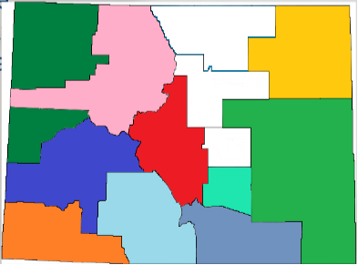
Ten Regions of the CO BoS CoC
“The graphic design skills and detail are amazing!”
-Anonymous real life reviewer that is real and exists and a professional graphic designer as well.
Notes:
Quick map showing Colorado’s BoS Regions

Slide 5

Intro to the Point-in-Time (PIT) Count
(PLEASE SEE THE “POINT-IN-TIME COUNT FACT SHEET” FOR MORE IN-DEPTH INFORMATION.)
What is a A point-in-time (PIT) count?
A PIT Count is an annual survey of the number and characteristics of unhoused people at a single point in time. Methodology requires the Point-in-Time take place on a single night in the last 10 days in January.
Date of the Count:
The BoS CoC has typically chosen Tuesday evenings to hold the PIT count and the count for 2023 will take place on Tuesday January 24th, 2023. We will be conducting a sheltered & unsheltered Point-in-Time Count in 2023.

Slide 6
Intro to the PIT Count Continued…
Again, we are surveying individuals based on where they spent the night on Tuesday January 24th, 2023.
Because of this, surveys for a sheltered and unsheltered count will generally begin after 10:30 PM on Tuesday January 24th and 12AM on Wednesday the 25th of January, 2023 into the early mornings. This ensures accuracy as to where someone spent the night on 1/24/2023.
Many communities opt to begin surveying individuals on Wednesday 1/25/2023 in order to avoid the cold of the evening. Survey questions are always asked based on where individuals spent the night on Tuesday 1/24/2023 and should not be asked prior to Tuesday evening.
  So the questions can be asked that Wednesday and up to a few days after.
  The maximum any community should survey individuals is up to 7 days, but that should be avoided as people may begin to forget where they spent the night on Tuesday 1/24/2023.

Slide 7
Sheltered PIT Count Definitions
Sheltered Point-in-Time Counts are completed every year and are the primary focus on even years.
Sheltered Counts focus on surveying individuals experiencing homelessness who are living in Emergency Shelter (ES) and Transitional Housing (TH) programs.
  These programs are tracked by the Continuum of Care and are contacted each year to collect surveys.
Each year we also count the number of people living in Rapid Rehousing (RRH), Permanent Supportive Housing (PSH), and Safe Haven (SH) programs.
  We are not required to complete full surveys of individuals living in this programs as they are considered permanent housing. Therefor we primarily count the number of people in these programs with some breakdown of households for RRH programs.
  It’s a much simpler process, so remember not to complete a full survey for people in these program types!
Notes:
All housing programs will hear directly from Coordinators and/or Shawn Hayes regarding updated housing inventory numbers for 2023.

Slide 8
Unsheltered PIT Count Definitions
The BoS conducts Unsheltered + Sheltered counts every odd year. During unsheltered counts we survey individuals who are experiencing literal, unsheltered homelessness.
For the PIT Count, unsheltered homelessness is defined as: An individual or family with a primary nighttime residence that is a public or private place not designed for or ordinarily used as a regular sleeping accommodation for human beings, including a car, park, abandoned building, bus or train station, airport, or camping ground."
HUD would generally consider individuals and families sleeping in a garage, shed, or other location outside of a housing structure, but on the property of a housing structure as “unsheltered” homeless for purposes of the PIT count.
HUD would not consider any individual or family sleeping inside of a housing structure as unsheltered homeless, even if the room inside of that housing structure is not typically used for sleeping (e.g., a kitchen or bathroom).
HUD would still consider persons sleeping in the hallway of an apartment or hotel (i.e., outside of an apartment unit or hotel room) as unsheltered.
Notes:
For the purposes of the Youth Unsheltered Count and Youth Supplemental Survey (YSS), there are slight differences in what is considered “unsheltered”. We will discuss this when going over the YSS later. Also, Kippi Clausen is hosting a training at 3PM this afternoon to diver deeper into the Youth PIT Count and its importance, especially since we were awarded the Youth Homelessness Demonstration Program (YHDP) grant!

Slide 9
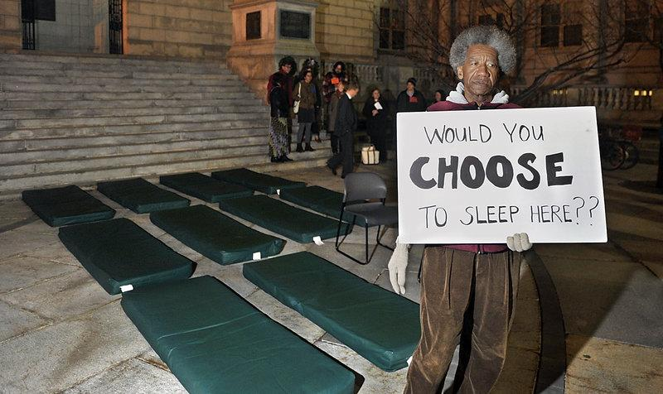
Homelessness
There have been requests to discuss homelessness for those who may not work in human services and may be volunteering with something like this for the first time.
We’ll take the next few slides to go over some basics regarding homelessness and working with people experiencing homelessness.

Slide 10

Homelessness
If talking to people experiencing homelessness is new to you, make sure you lean on any leads and staff members who you encounter the day of the count. We’ll dive further in to Privacy, Security, and Safety in the next section as well.
For now, we will focus on information that may help better shed light on homelessness and helpful ways to work with people in this traumatic situation!

Slide 11
Homelessness
Homelessness is an issue faced across the world, caused by many intersecting factors. In the United States, some of these include, but are not limited to systemic factors around:
Systemic Racism, including Discriminatory Housing Practices like redlining and housing discrimination that impact individuals and families across generations (1.)(4.)
Insufficient Income (2.)(4.)
Lack of Affordable Housing (2.)(4.)
Survivors of people who perpetrate Domestic Violence (2.)(4.)
Poverty (2.)(4.)
Mental Health and lack of needed services (2.)(4.)
Substance use and lack of needed services (2.)(4.)
Youth Homelessness and LGBTQIAA2S+ intersections (3.) (4.)
LGBTQIAA2S+ Homelessness and intersections (4.)
Notes:
References:
SPARC Phase 1 Study Findings regarding the impact of racism (vs. deep poverty) on homelessness: https://center4si.com/wp-content/uploads/2016/08/SPARC-Phase-1-Findings-March-2018.pdf
National Law Center on Homelessness & Poverty Homelessness in America: 2018 Overview of Data and Causes: https://nlchp.org/wp-content/uploads/2018/10/Homeless_Stats_Fact_Sheet.pdf
The Trevor Project: Homelessness and Housing Instability Among LGBTQ Youth: https://www.thetrevorproject.org/research-briefs/homelessness-and-housing-instability-among-lgbtq-youth-feb-2022/#:~:text=28%25%20of%20LGBTQ%20youth%20reported,to%20those%20with%20stable%20housing
LGBTQ+ Homelessness: A Review of the Literature: https://www.ncbi.nlm.nih.gov/pmc/articles/PMC6695950/

Slide 12
Homelessness
Some other reasons for Homelessness can include, but are not limited to:
Job Loss (Whether being laid off, injured on the job, etc.)
Health/Medical Issues
Familial and other reactions to LGBQIAA+, Transgender, and gender non-conforming youth and family members coming out
Notes:
References:
SPARC Phase 1 Study Findings regarding the impact of racism (vs. deep poverty) on homelessness: https://center4si.com/wp-content/uploads/2016/08/SPARC-Phase-1-Findings-March-2018.pdf
National Law Center on Homelessness & Poverty Homelessness in America: 2018 Overview of Data and Causes: https://nlchp.org/wp-content/uploads/2018/10/Homeless_Stats_Fact_Sheet.pdf
The Trevor Project: Homelessness and Housing Instability Among LGBTQ Youth: https://www.thetrevorproject.org/research-briefs/homelessness-and-housing-instability-among-lgbtq-youth-feb-2022/#:~:text=28%25%20of%20LGBTQ%20youth%20reported,to%20those%20with%20stable%20housing
LGBTQ+ Homelessness: A Review of the Literature: https://www.ncbi.nlm.nih.gov/pmc/articles/PMC6695950/

Slide 13
Homelessness
When working with individuals and families who are experiencing homelessness, know that there may be any number of reasons they are in this situation.
To increase understanding, it might be helpful to imagine what things might have to happen for you to potentially face homelessness yourself. Can you name 1-5 things that might happen that could cause homelessness? Lost family supports? Income? Ability?
Sometimes recognizing how easy it could be for all of us to face this situation can help empathize with the people we talk with while completing surveys.

Slide 14





Know the each person does have a unique though oftentimes shared experience of homelessness. Some may be living with severe mental health issues or actively using substances. Another might have faced job loss due to racist harassment by co-workers or their boss. You may meet individuals fleeing domestic violence or someone who couldn’t afford to pay rent vs. fix a broken down car and get to work. There are any number of reasons people experience homelessness.

Slide 15
Homelessness
Each experience is valid and true to that person or family and should be honored by you as the surveyor.
Your goal is to help explain the survey to the best of your ability and record the responses, while also helping to connect to resources if needed.
It’s a unique honor and privilege to be trusted with this information.
Approach each encounter from a place of respect, empathy, non-judgment, authenticity, and trust. Those participating will recognize your intentions as a surveyor when these things are at the forefront!
Notes:
Symptoms of Severe Mental Health and/or Substance Use - Know that the person you’re interacting with is experiencing reality in the way they are describing to you. You may have to ask questions in different ways to get the information you need. You may be able to lean on other volunteers or people who have experience to get support. Otherwise best advice is to listen and work with the person to get the best information you can.

Slide 16


Slide 17
Covid Safety
The following website from the CDC provides specific guidance on Unsheltered Homelessness Safety Precautions to utilize for Covid-19: https://www.cdc.gov/coronavirus/2019-ncov/community/homeless-shelters/unsheltered-homelessness.html
Topics Include:
Community coalition-based COVID-19 prevention and response
Communication
Considerations for outreach staff
Considerations for people experiencing unsheltered homelessness
Considerations for encampments
Considerations for a Long-Term Infection Prevention Strategy for People Experiencing Unsheltered Homelessness
Interim Guidance for Homeless Shelters
COVID-19 Readiness Resources
Notes:
Safety will be community based and can be discussed with coordinators of counts.

Slide 18
Health Precautions
In response to COVID-19, please follow the suggested guidelines for conducting the unsheltered and sheltered counts:
We ask all volunteers to bring masks (or the agency you’re assisting will provide them) and wear them for the duration of the 2023 PIT Count and other volunteer efforts if required.
  Masks and hand sanitizer may be provided, but you may want to bring your own just in case.
Teams should follow distancing guidelines set by coordinators, agencies, and the CDC if in practice.
We recommend that any volunteer be tested for COVID-19 prior to participation in the count no more than 7 days prior, or at least screen for symptoms and check temperatures prior to and after a shift. The PIT Leads should coordinate this.

Slide 19

Connection to other services
Make sure to have information about additional service referrals should they exist in your community. The PIT Coordinator and/or Lead should be able to provide these resources.
Referrals can include, but are not limited to:
Food Banks
Daytime Warming Spaces
Other Community Shelters
Domestic Violence Survivor Resources
Emergency Services
Services for other special populations like youth, veterans, elderly/disabled, etc.
Notes:
This may include connecting survey participants to another agency.

Slide 20

Privacy, Security, & Script
Familiarize yourself with the Instructions & Script for the 2023 PIT Unsheltered & Sheltered Surveys, which helps:
Identify a private, safe space to ask survey questions
Informs participants about Covid-19 Safety and Precautions.
Inform participants about the nature of the survey questions.
Inform participants about how data is collected and how their information is used/protected.
Reminds surveyors to answer EVERY applicable question on the surveys, as long as the client does not refuse to answer.
Notes:
Please work with agency leads to speak with volunteers in advance in order to make sure safety of the surveyors and the survey participants is respected.

Slide 21
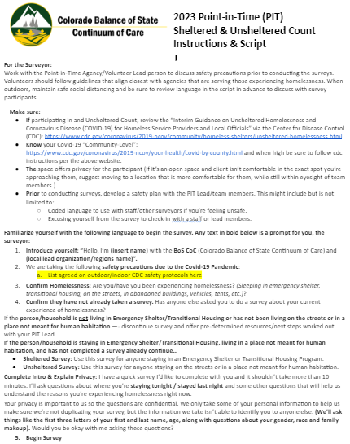
Script
A script containing information on safety precautions and instructions/language to conduct the survey is available for the PIT Count in 2023.
2023 Point-in-Time (PIT) Unsheltered & Sheltered PIT Instructions and Script:
Notes:
Surveyors should be directed to complete a few surveys and then bring to the leads in order to make sure the forms are being completed correctly. This will hopefully help address any issues ASAP and perhaps correct any problems.
As noted on the survey form, mark “R” legibly if there are any refusals so that we know the question was not just skipped.

Slide 22
Homeless Management Information System (HMIS) Data and the PIT Count
The HMIS System can pull data to complete PIT Count surveys for programs, but a special “Attendance” module must be used the night of the count in order to record attendance.
To set this up you must speak with the HMIS Program Manager as soon as possible. Open a ticket with the HMIS Team: Email: colorado.hmis@coloradocoalition.org
I will complete a special 5-10 minute training that will be included in the website by tomorrow that goes over this module in more detail based on an amazing PowerPoint created by Denny Wetmore. I’m not including it today just to save time.

Slide 23
Review of The Sheltered & Unsheltered PIT Count Survey Forms
Notes:
We will review both survey forms for the Sheltered and Unsheltered counts.

Slide 24
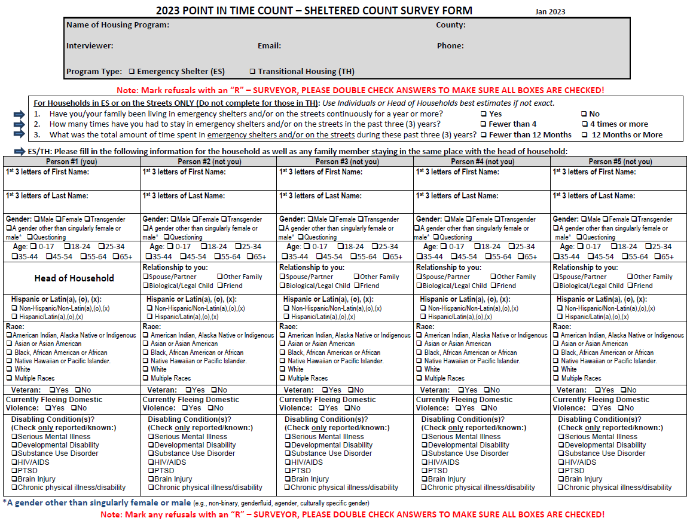
Notes:
Sheltered Count Survey Form Overview

Slide 25
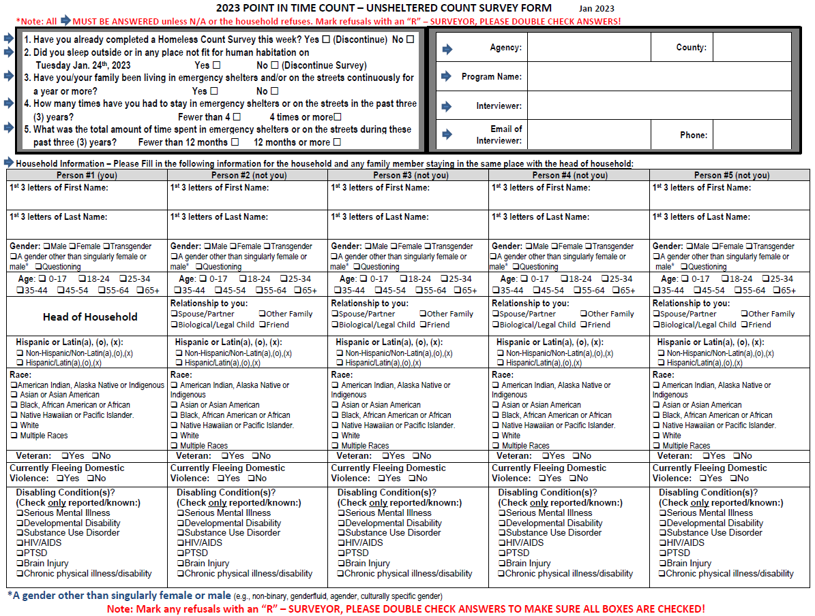
Notes:
Unsheltered Count Survey Form Overview

Slide 26
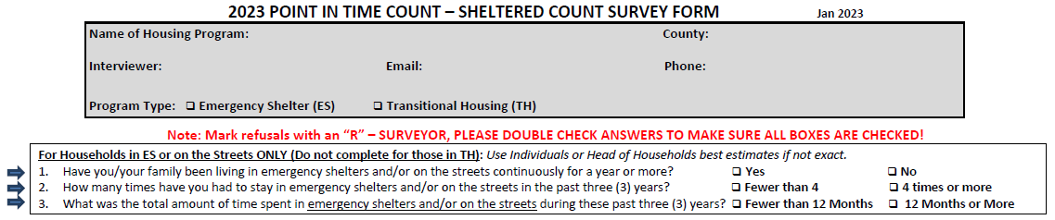
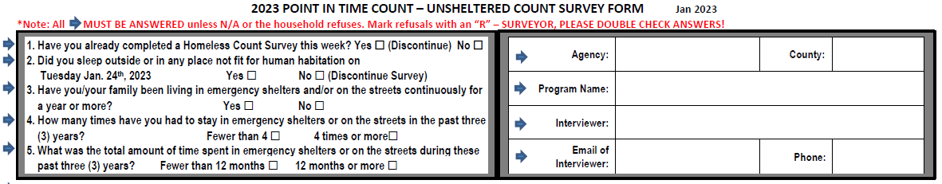
First Section - Unsheltered & Sheltered Count Surveys
Notes:
Please note, The differences between the Sheltered Count and the Unsheltered Count lie in the top part of each survey as you can see from the images pulled from each survey above. The bottom half of both surveys contains the same de-identifying and demographic questions. In the next slides we’ll go through each of the top sections of the Sheltered and Unsheltered Survey forms before diving into the demographic questions to make sure it’s clear what information should be asked/entered by the surveyors for both survey types.

Slide 27

IMPORTANT!
This can’t be emphasized enough. It’s extremely important to answer EVERY applicable question on the survey forms LEGIBLY.
Incomplete or hard to read survey forms can not be used.
Notes:
If possible check-in with a Lead after some surveys have been complete to make sure the forms are being completed in the necessary way and to answer any questions that come up.
Note: If a question is refused, follow directions on the survey and mark an “R” in the space that is refused. This will help us know that it has been refused and not missed.

Slide 28
Refusals
Individuals and Families are free to refuse to answer any question on the survey, but typically do so because they are either not understanding what the surveyor is asking or may not know enough about how we de-identify survey answers.
Again, familiarize yourself with the questions to explain the reason for the question and how it helps to have each survey to be answered completely and legibly.
Be able to give examples of various parts of the survey, especially around questions that may require more thought. (ie. questions around disabilities/substance use, gender, etc.)
We want to be sure to give every opportunity for complete data on the surveys.
Notes:
We will discuss this further when breaking down the surveys.

Slide 29
First Up: Sheltered Count Survey Form - Top Part

Slide 30
Sheltered Survey Program Information
Name of Housing Program
  Name of the housing program/shelter where the person spent the night as reflected in the 2023 Housing Inventory. (E.g. Chaya House, Abraham Connection Winter Shelter, Elko Shelter, etc.)
Continued…
Notes:
It’s recommended that the volunteer complete this information for surveyors and make copies with the appropriate name of the housing program to lessen confusion. Please encourage programs NOT to change the name of the program to a “nickname” they generally use. When compiling data, having the accurate program name lessens confusion.
An example of what seems to happen could be “Abraham Connection Winter Shelter”, which is located in Delta City/County, might be known as “Delta Winter Shelter” by people in the community. The Surveyor might then cross out “Abraham Connection Winter Shelter” and put in “Delta Winter Shelter” instead. While this might help the surveyors, it is confusing for those compiling the data and can cause surveys to be discarded/associated with the wrong program.

Slide 31
PROGRAM INFORMATION CONTINUED…
County:
  The county where the program resides. (E.G. Pueblo, La Plata, Morgan, Larimer, Grand, Weld, etc.)
Interviewer:
  Name of the surveyor
Email:
  Contact email for the surveyor
Phone:
  Phone number for the surveyor
Continued…
Notes:
We ask for the contacts of the actual surveyor in case we need to reach out with questions. *Go to next slide.

Slide 32
PROGRAM INFORMATION CONTINUED…
Program Type:
  ES – Emergency Shelter
  TH – Transitional Housing
This is based on the Housing Inventory “Programs to be Surveyed” list(s) sent to Coordinators and Regions by CCH. If you’re a volunteer/surveyor, the person organizing the count will have this information.
Continued…
Notes:
Your Regional PIT Coordinator should have the list of programs CCH sent regions, and the survey form. They may already be checked, but make sure you confirm the program type with them if there’s any confusion.
Quick Definitions:
Emergency Shelter (ES) “…any facility, the primary purpose of which is to provide temporary or transitional shelter for the homeless in general or for specific populations of the homeless.”
Transitional Housing (TH) “A project that has as its purpose facilitating the movement of homeless individuals and families to permanent housing within a reasonable amount of time (usually 24 months). Transitional housing includes housing primarily designed to serve deinstitutionalized homeless individuals and other homeless individuals with mental or physical disabilities and homeless families with children.”

Slide 33
Why Ask for Contact Information on the Surveyor Directly?
We want CCH/our consultant and/or the BoS Coordinator to be able to speak directly with the person who completed the form if there are any questions or clarifications needed.
Notes:
We want to be able to contact the actual person who completed the survey with any questions or clarifications. Some PIT Coordinators either act as the main surveyors or add their information in these spots because they have easy ways of contacting the surveyors with questions. When CCH receives the surveys we do go through and try and make sure every answer is completed and if there isn’t a listed reason of why they are not answered we’ll reach out to surveyors directly to see if they might be able to answer the question.

Slide 34
EMERGENCY SHELTER QUESTIONS
These questions help identify whether or not someone might be considered “chronically homeless” and should be asked for people in Emergency Shelters or people on the streets only, as indicated on the survey.
ES only: Have you/your family been living in emergency shelters and/or on the streets continuously for a year or more?
  Yes
  No
How many times have you had to stay in emergency shelters or on the streets in the past three (3) years?
  Fewer than 4
  4 times or more
What was the total amount of time spent in emergency shelters or on the streets during these past three (3) years?
  Fewer than 12 months
  12 months or more
Notes:
Surveyors should not worry about over explaining these questions. Participants should be directed to give their best answer with the question as listed and surveyors should record those accordingly. These questions establish whether or not the person or family might be considered “Chronically Homeless”, which HUD defines using this criteria along with the demographics in the bottom half of the Surveys. There is much more that goes in to this definition, but these questions do a good job of gauging this status.

Slide 35
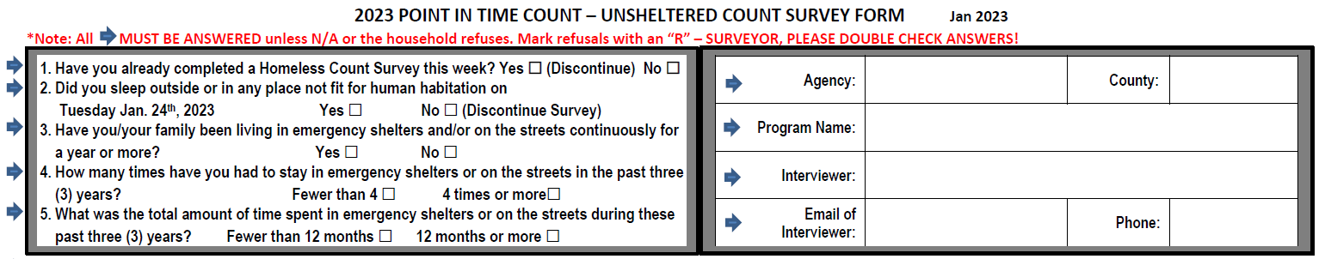
First Section - Unsheltered Count Survey
Notes:
Adding this because the first section of the Unsheltered Count Survey is very similar to the Sheltered Count Survey with a few key questions that are different.

Slide 36
Unsheltered Survey Information
Agency
  This can be the agency coordinating the count, the group who is volunteering, the geographic area being covered, the group coordinating for the county, etc. It really depends on how the region is structuring the Unsheltered Count. This should help the PIT Coordinators understand where the Unsheltered Count took place.
County/Interviewer/Email/Phone
  The other contact information is requesting the same as the sheltered count survey so I won’t go over it again.
Continued…
Notes:
It’s recommended that the Coordinators complete this information for surveyors and make copies with the appropriate name of the programs/groups/geographic areas to lessen confusion. For an Unsheltered Count this might be a geographic area like “Pikes Peak Encampment”. It might also be “Cross Streets Main & First Montrose, CO” or “San Luis Valley Cold Weather Day Warming Center”.

Slide 37
Left Box - Survey Questions
Have you already completed a Homeless Count Survey this week?
Yes ☐ (Discontinue) No ☐
Did you sleep outside or in any place not fit for human habitation on Tuesday Jan. 24th, 2023 Yes ☐ No ☐ (Discontinue Survey)
Questions 3-5 ask the same questions that the Sheltered Count Survey asks, so we will not go over those again to save time.
Next Up: Demographic questions asked in both the Sheltered and Unsheltered Survey forms!
Notes:
1 is attempting to reduce duplication of surveys and jog a persons memory to make sure they haven’t already completed a survey. This is especially important if communities are completing surveys after the night of 1/24/2023 and moving more into Wednesday afternoon or later days.
2. Is attempting to understand if a person was experiencing unsheltered homelessness and following HUD’s “literal homelessness” definition, which we went over at the beginning of the presentation.

Slide 38
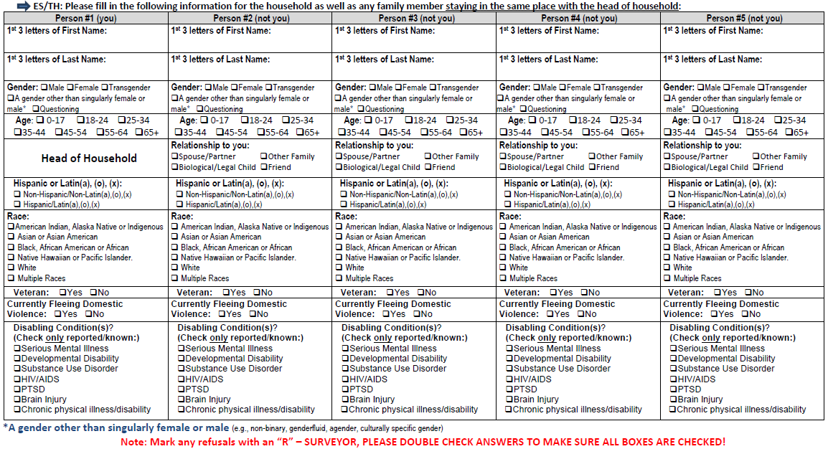
Demographics

Slide 39
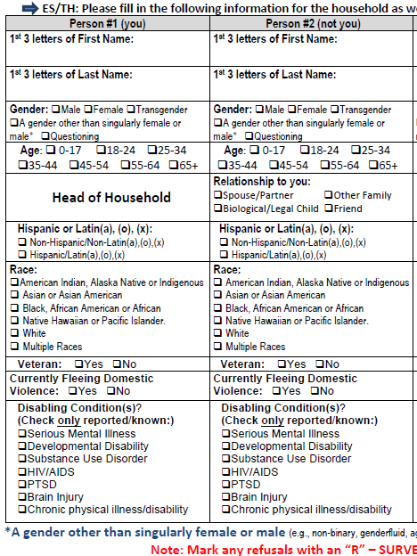
Demographic Questions
“Please fill in the following information for yourself as well as any family member staying in the same place with you:”
Make sure to use the box(es) to the right for any other household members with the Head of Household (HoH).
There are 4 boxes for household members in addition to the head of household (HoH), “Person #1 (you)” or HoH, “Person #2 (not you)”, etc.”
If there are more then four household members then use another survey, skip head of household, and make sure it’s paired with the HoH survey.
Notes:
This helps to remind surveyors that participants know that we’re only recording answers for household members with them at the time of the survey. This may get confused at times by those in their lives that aren’t physically with them at the time of their homeless experience. (Example, a partner out of state or children living with an ex partner/Child Welfare on the night of the count.)
Reminder that there are spaces for up to 5 persons on one survey form for the Sheltered Count. If you have more than 5 family members you can copy the same info in to the first part of the survey and start the second survey page with “Person #2 (not you)” to indicate they’re a member of the household. Remember to keep those surveys together and indicate they are the same survey! Even marking with first three letters of the familys last name and Page 1/Page 2 to help us track the pages if they get separated.

Slide 40

Head of Household
A family should include one adult or minor head of household. The surveyor will put that person’s information in the “Person #1 (You)” box.

Slide 41

Name
“1st 3 Letters of First Name
1st 3 Letters of Last Name”

Slide 42
GENDER IDENTITY
2023’s options for gender have stayed the same as 2022’s.
“Gender:
Male
Female
Transgender
A gender other than singularly female or male…*
Questioning
  See bottom of the survey for remainder of option 4. *A gender other than singularly female or male (e.g., non-binary, genderfluid, agender, culturally specific gender)

Slide 43
Some Definitions...
GENDER CONTINUED…
Gender identity - One's innermost concept of self as male, female, a blend of both or neither – how individuals perceive themselves and what they call themselves. One's gender identity can be the same or different from their sex assigned at birth.
Transgender - An umbrella term for people whose gender identity and/or expression is different from cultural expectations based on the sex they were assigned at birth. Being transgender does not imply any specific sexual orientation. Therefore, transgender people may identify as straight, gay, lesbian, bisexual, etc.
Non-binary - is used to describe people who feel their gender cannot be defined within the margins of gender binary. (male/female)
Gender Fluid - “...Genderfluid individuals have different gender identities at different times. A genderfluid individual's gender identity could be multiple genders at once and then switch to none at all, or move between single gender identities, or some other combination therein.”
Agender - “…Agender individuals find that they have no gender identity, although some define it more as having a gender identity that is neutral.”
Gender expression - External appearance of one's gender identity, usually expressed through behavior, clothing, haircut or voice, and which may or may not conform to socially defined behaviors and characteristics typically associated with being either masculine or feminine.
Definitions obtained from the Human Rights Campaign - https://www.hrc.org/resources/sexual-orientation-and-gender-identity-terminology-and-definitions and the lgbt foundation - https://lgbt.foundation/who-we-help/trans-people/non-binary
Notes:
(Only read this, do not read each definition during presentation.)
We wanted to provide some definitions for anyone who may not be familiar with some commonly used terms around gender and gender identity. HUD is now recognizing that gender extends beyond the gender binary we are traditionally taught in our culture.
“Gender binary” – noun : the idea that there are only two genders and that every person is one of those two.
It is important to be inclusive in our language and have access to definitions in case people have questions about these terms.

Slide 44
Gender Identity Continued
Asking for Gender Identity:
“What gender do you identify with?”
If the person does not understand the question or asks for clarification...
“Some examples include: Male, Female, Transgender, Gender non-binary.”
If there are further questions about Transgender or Gender non-binary identities, a quick explanation for people who have questions can be:
“We want to respect the identity of all the people we survey and some do not identify with the sex/gender they might present with or that they are assigned at birth.”
Notes:
Sex refers to biological differences; chromosomes, hormonal profiles, internal and external sex organs.
Gender describes the characteristics that a society or culture delineates as masculine or feminine.
http://www.med.monash.edu.au/gendermed/sexandgender.html

Slide 45

Age
“Age: ❑ 0-17 ❑18-24 ❑25-35 ❑ 35-44
❑ 44-54 ❑55-64 ❑ 65+”
HUD has expanded these options in 2023 to include a greater range of ages.
Enter the age reported by the participant for all household members as directed by the survey form and to the best of the head of household/household members knowledge.
Simply asking a person's age may be the simplest method of gathering this information. You may also need to use math based on a person’s date of birth.

Slide 46
Ethnicity
HUD guidance allows for the following “Ethnicity” categories in PIT Surveys. There are no changes in 2023 from 2022.
“Ethnicity
Non-Hispanic/Non-Latin(a)(o)(x)
Hispanic/Latin(a)(o)(x)”
Hispanic/Latin(a)(o)(x) - HUD defines this as “A person of Cuban, Mexican, Puerto Rican, South or Central American, or other Spanish culture or origin, regardless of race. The term “Spanish origin” can be used in addition to “Hispanic” or “Latin(a),(o)(x).”
Not Hispanic or Latin(a),(o),(x) - HUD defines this as “A person not of Cuban, Mexican, Puerto Rican, South or Central American, or other Spanish culture or origin, regardless of race.”
Notes:
HUD directs people being surveyed to answer which ethnicity they identify with, closest to the provided categories.

Slide 47
Race
HUD guidance allows for the following “Race” categories in PIT Surveys. There are no changes in 2023 from 2022.
“Race:
American Indian, Alaska Native or Indigenous
Asian or Asian American
Black, African-American or African
Native Hawaiian or Pacific Islander
White
Multiple Races”
Notes:
HUD directs people being surveyed to answer which race they identify with, closest to the provided categories.
These are HUD provided categories and there is work being done to change them in the future to better reflect cultural

Slide 48
Multiple Races
For the purpose of HUD data reporting, people that identify with multiple race categories should only be counted under “multiple races” and should not be counted in each specific race category they identify with.
Example: “Jane indicated that they are “Black, African American or African” and “White.” For the PIT count, Jane is only included in the count of persons who are “multiple races” and is not included the count of persons who are “Black, African American or African” or “White.”
Notes:
The Youth Supplemental Survey dives deeper in to identities and backgrounds.

Slide 49
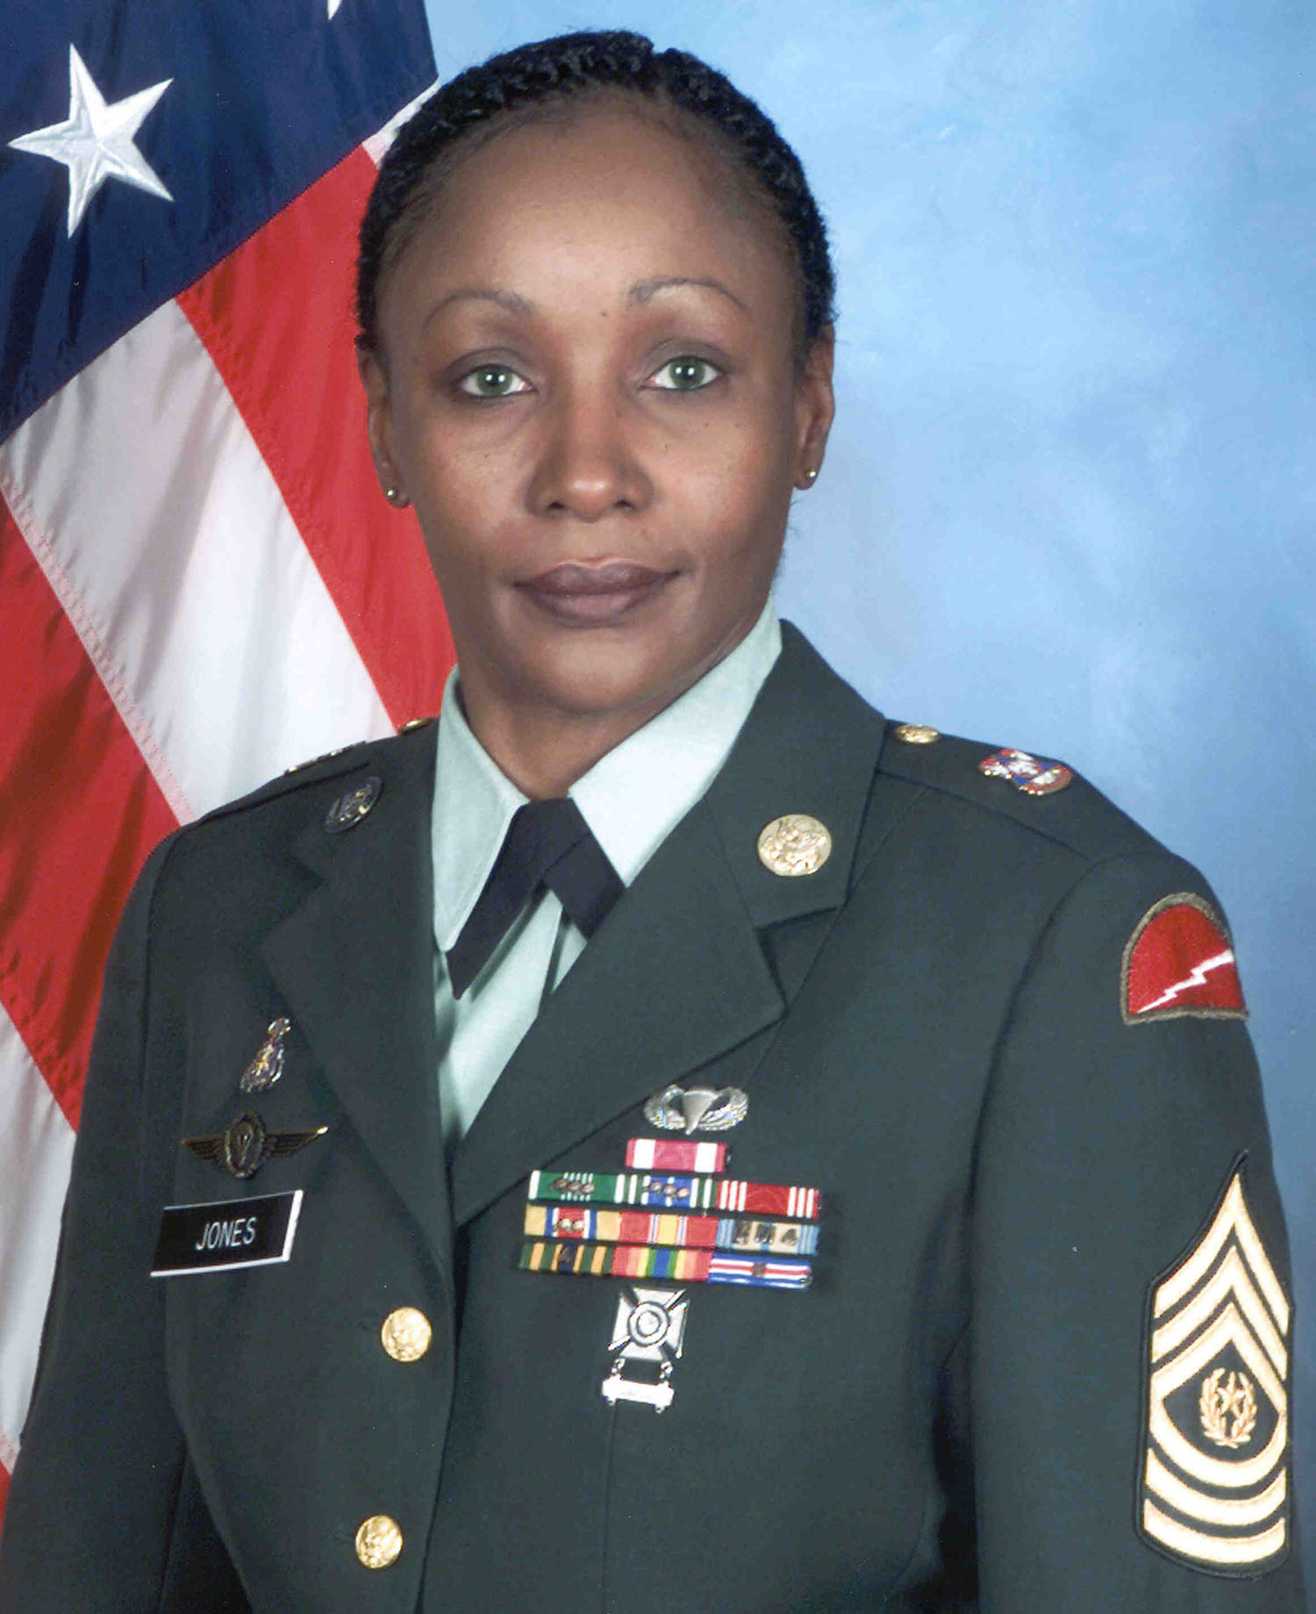
Veteran Households
“Veteran: ❑Yes ❑No”
A “veteran” household includes households with one or more veterans who might be presenting with other persons.
You check the box only for the household member who is a veteran.
Notes:
The veteran may or may not be the “Head of Household”. Indicate this status for the appropriate household member.

Slide 50
Domestic Violence
“Currently Fleeing Domestic Violence: ❑Yes ❑No”
Since 2018, HUD has required that data reported on survivors of domestic violence should be limited to reporting on those who are currently experiencing homelessness because they are fleeing domestic violence, dating violence, sexual assault, or stalking, as opposed to reporting on survivors who have ever experienced these circumstances.

Slide 51
Disabling Condition(s)?
“Disabling Condition(s)?
(Check only reported/known:)
Serious Mental Illness
Developmental Disability
Substance Use Disorder
HIV/AIDS
PTSD
Brain Injury
Chronic Physical Illness/Disability
Check off only Disabling Conditions the survey participants report being diagnosed with or experiencing. If you know of some conditions that the participant may have forgotten/left out, you can add them.
Similarly to other categories, a surveyor should seek the closest answer based on the participant’s understanding of their condition and their understanding based on the relationship they have developed with the participant.
Notes:
You should record the clients answer as they understand their condition(s), but if it’s helpful to describe what to look for, here are some definitions for those unfamiliar with these terms...

Slide 52
Disabling Condition(s)?
You should record the clients answer as they understand their condition(s), but if it’s helpful to describe what to look for, here are some definitions for those unfamiliar with these terms…
Serious Mental Illness - Examples: Major Depressive Disorder (Depression), Bipolar DIsorder, Anxiety Disorder, Schizophrenia, Schizoaffective DIsorder, Delusional Disorder, etc.
Developmental Disability - Examples: Intellectual Disability (Previously Mental Retardation), chromosomal disorders, Autism Spectrum Disorder (ASD). Another definition can be “generalized neurodevelopmental disorder characterized by significantly impaired intellectual and adaptive functioning.”
Substance Use Disorder - Includes any diagnosis of substance use disorder. “Substance use disorders occur when the recurrent use of alcohol and/or drugs causes clinically and functionally significant impairment, such as health problems, disability, and failure to meet major responsibilities at work, school, or home.”
Notes:
Depending on time, either read through or ask that people refer to the presentation/pdf.

Slide 53
Disabling Condition(s)?
HIV/AIDS - Diagnosed with either HIV or AIDS
PTSD - Post Traumatic Stress DIsorder - “PTSD (posttraumatic stress disorder) is a mental health problem that some people develop after experiencing or witnessing a life-threatening event, like combat, a natural disaster, a car accident, or sexual assault.”
Brain Injury - As the name implies, injury to the brain either from direct trauma like a car accident or shaken baby syndrome or indirect trauma like complications during childbirth or oxygen deprivation. Traumatic Brain Injury (TBI) is a common name associated with this type of injury.
Chronic Physical Illness/Disability - an enduring health problem that will not go away – for example: diabetes, asthma, arthritis. Chronic physical illnesses can be managed, but they cannot be cured.

Slide 54
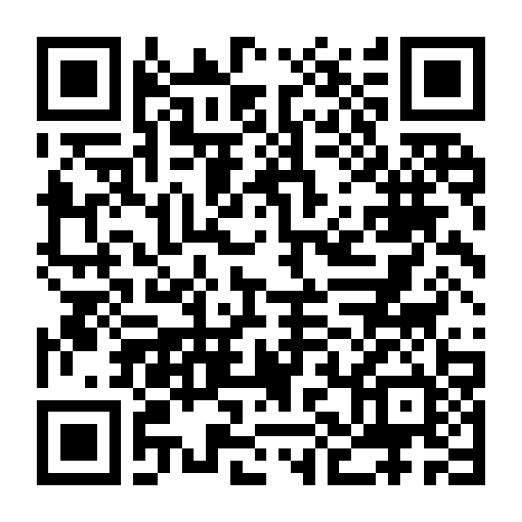
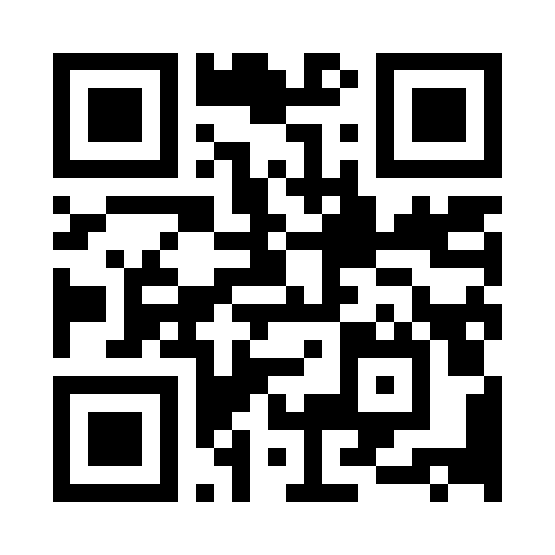
Electronic Survey
Let’s take some time to go through the PIT Electronic Survey. To save time I will go through the Unsheltered Count Survey only and complete a survey with fake information. However, here are the links for all surveys.
Unsheltered count survey
Browser link: https://arcg.is/1emnCz
  Brings you to a web browser you can use to complete surveys.
  You must be connected to the internet to use this option.
App Link: https://survey123.arcgis.app?itemID=09763a2829234afea79b9cc2f50bd53b
  App link brings you to a page to download the app to your device. Microsoft, Apple,
and Google compatible.
  Offline mode available.
—----------------------------------------------------------------------------------------------------------------------------------------------------------
Sheltered count survey
Browser link: https://arcg.is/uKLru
  Brings you to a web browser you can use to complete surveys.
  You must be connected to the internet to use this option.
App link: https://survey123.arcgis.app?itemID=aa2140bf59904d438e182ecb2f36d57b
  App link brings you to a page to download the app to your device. Microsoft, Apple,
and Google compatible.
  Offline mode available.

Slide 55
Unsheltered Counts - Observational Counts
Observation-only counts: produce a head count without verbal or physical interaction between people experiencing unsheltered homelessness and those conducting the PIT count. Thus, observation-based data collection activities must be conducted late at night, when it is reasonable to assume someone is experiencing unsheltered homelessness by virtue of the time and place they are located or sleeping. Typically, observation-only counts are conducted only on the night designated for the PIT count.
(i.e., between the hours of 10pm on the night of the count and 6am the next morning), though HUD is providing some flexibility to count people in distinct geographies on consecutive nights if needed to reduce the number of volunteers needed to conduct the count.
Notes:
HUD has stated that Observational Counts should be conducted without assumption of demographic information, so if you are participating in the observational count you would only be producing a head count based on observation of unsheltered spaces where people experiencing homelessness are living on the night of the count.
Counting on multiple nights would be allowed if there is advanced knowledge that the populations you’re counting do not move between geographic locations regularly.

Slide 56
Unsheltered Counts - Observational Counts
To document surveys of observational counts, utilize unsheltered surveys for each individual or family being observed and Agency names like “Encampment 1”, “Encampment 2”, “3rd & Main Street Encampment”, etc.
You must deduce the number of people and other information in the survey to the best of your ability. If you can see physical characteristics, provide them. Descriptors, clothing, etc. Observational counts are used just to gain a ‘head count’, so please avoid recording demographic traits like gender, race, etc. This can complicate things and unless you know for certain isn’t advisable.
System of documentation for survey differentiation can include Obs1, Obs2, Obs3, etc. The information regarding the different geographic locations further assists with deduplication especially when the observational counts are done closest to 1/24 or in geographic areas not easily accessible. There is an electronic survey available for Observational Counts.

Slide 57
Rapid Rehousing (RRH)
&
Permanent Supportive Housing (PSH) Programs
Shawn will send you a separate email with the forms and directions to count he individuals in your programs if the data cannot be pulled directly from the Homeless Management Information System.
YOU DO NOT NEED TO DO ANY SURVEYS FOR YOUR PARTICIPANTS. We just need a count of the total number of people in your programs with a special breakdown for RRH participants.

Slide 58

Youth Supplemental Survey
The Office of Homeless Youth Services (OHYS) and the Advisory Council for Homeless Youth (ACHY) will work in collaboration with the Rural Collaborative for Homeless Youth (RCHY) to conduct a Youth Unsheltered Count along with a Youth Supplemental Survey in 2023.
Notes:
Help communities identify the unique needs and systems involvement of young adults experiencing homelessness, and impacts how the Division of Housing structures support around addressing support.
Also, Kippi Clausen with the Rural Collaborative for Homeless Youth have again been supporting regional coalitions to utilize the Youth Supplemental Survey and also conduct a separate Youth Unsheltered Count in some regions. She and Brittany are the primary contact for those efforts and can also answer your questions about the Youth Supplemental Surveys!

Slide 59
Clarification
The Youth Supplemental Survey is conducted independent of the 2023 BoS PIT Count, though we’re all working in collaboration with each other!
The BoS 2023 PIT Sheltered Count Surveys should be given priority over the Youth Supplemental Survey, as it is required by HUD and also collects necessary data the YSS does not.
Information gathered from the 2023 Youth Supplemental Survey will be used by communities to better understand their regional youth homeless needs, but is not reported to HUD though it is vital to collect and understand youth homelessness in Colorado!
  The completed report will be available on the OHYS website, check out the website for past years reports.
The 2023 BoS PIT Sheltered Count data will be the only data reported to HUD in 2023.
Notes:
OHYS Website URL: https://www.colorado.gov/pacific/dola/office-homeless-youth-services-ohys

Slide 60
Further Clarification
The YSS should be completed for any unaccompanied youth between the ages of 11 to 24, whether they are experiencing unsheltered homelessness or a program participant in Emergency Shelter, Transitional Housing, Rapid Rehousing, or Permanent Supportive Housing.
  Youth homelessness is different from adult homelessness. Youth are considered homeless if “Doubled Up” or “Couch Surfing” for instance. This means if they are staying on someone's couch, they should be surveyed.
  If completing the YSS for someone in an RRH or PSH program, please complete both the Sheltered Count Survey form and the YSS Survey. This way all information on the Youth is collected.
Notes:
OHYS Website URL: https://www.colorado.gov/pacific/dola/office-homeless-youth-services-ohys

Slide 61
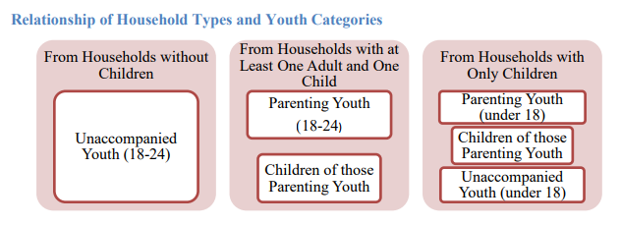
Which Youth do we Count in the Youth Supplemental Survey?
Notes:
Any youth 11-24 who is a part of a family with an adult should not be counted for the youth supplemental survey.
However, and this is important, they would be counted in the BoS Sheltered PIT Count as part of the family.

Slide 62
YSS Continued...
Age Range of Youth Supplemental Surveys: 11 through 24 (not yet 25)
So on the night of the count, you will count youth who were born on and AFTER:
1/25/1998
Just to be clear:
If born on 1/24/1998 or before: Don’t use supplemental survey!
If born on 1/25/1998 or later: Use Youth Supplemental Survey!
Notes:
The goal is to make sure you are not surveying someone with the youth supplemental survey who is 25 on 1/25=4, the night of the PIT Count.

Slide 63
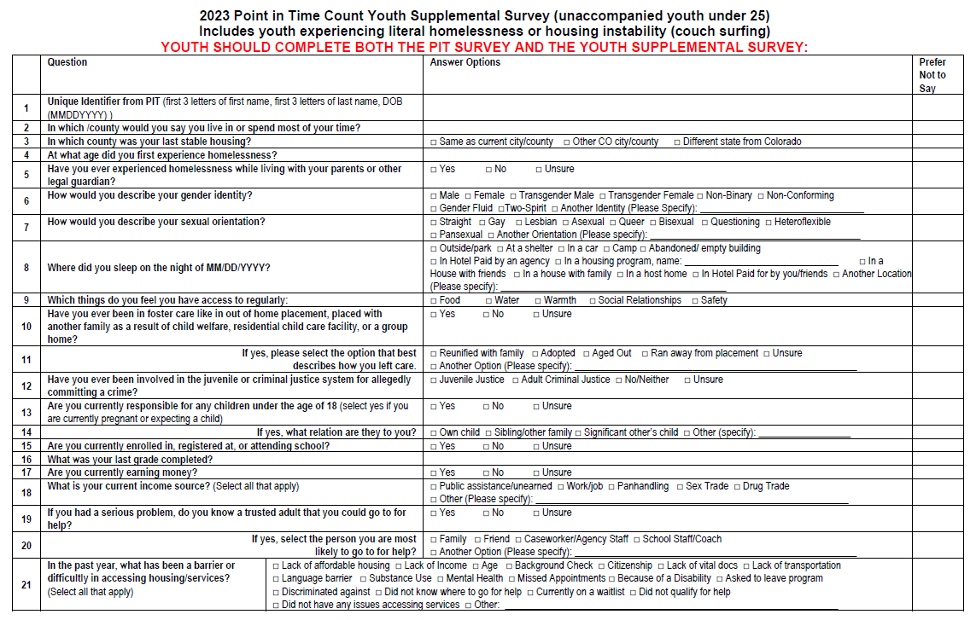
Youth Supplemental Survey Overview
and
Youth Unsheltered Count Information

Slide 64
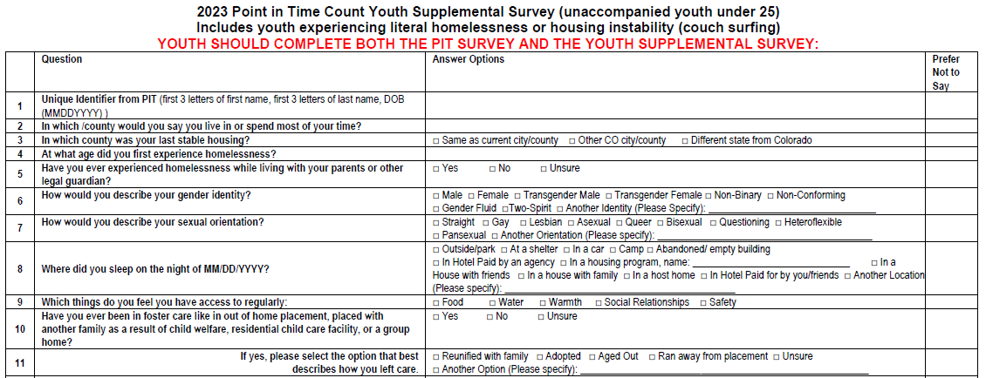
Youth Supplemental Survey Overview - First Half of Survey
Notes:
Consider the Homelessness section we discussed at the beginning of presentation. Youth are looking for the same kind of respect that you would provide an adult. There may be slight changes for youth under 18 depending, but oftentimes youth experiencing homelessness have been through some pretty rough situations and have had to deal with those things independently. It’s okay to speak to them exactly as you would speak to an adult. Always let kindness, compassion, and recognition of their strength in such a difficult situation guide your interaction and you should be fine.
Designed by youth, for youth. Youth felt these questions would capture their experience. May seem personal, so make sure to have a clear understanding of the reasons why you’re asking the questions. Also, knowing that their personal information is only being collected to make sure we can deduplicate the surveys can be very helpful. As with anyone who is providing such private information, it’s comforting to know that someone will not be able to trace the youth’s answers back to them.

Slide 65
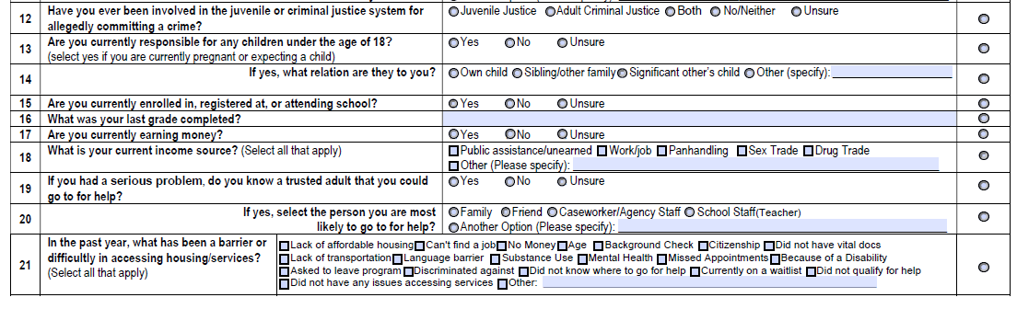
Youth Supplemental Survey Overview - Second Half of Survey

Slide 66
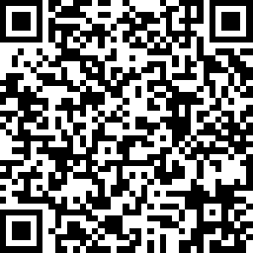
Youth Supplemental Survey - Electronic Survey
Complete the Youth Supplemental Survey electronically!
Follow this link to the simple survey monkey: https://www.surveymonkey.com/r/58XVKVZ

Slide 67
IMPORTANT!
This can’t be emphasized enough. It’s extremely important to answer EVERY applicable question on the survey forms LEGIBLY.
Incomplete or hard to read survey forms can not be used.
Notes:
Again, possible check-in with a Lead after some surveys have been complete to make sure the forms are being completed in the necessary way and to answer any questions that come up.

Slide 68
Survey Collection
Make sure to discuss where to turn the surveys in once they are complete. Generally you’ll turn them in to the PIT Coordinator or Agency Lead.
Date for turning in Surveys:
Surveyors should turn in surveys to the PIT Coordinator/Lead on the same day they complete surveys or by Wednesday 2/1/2023.
PIT Coordinators/Leads should compile the surveys by program, add cover sheets, and submit them to Shawn Hayes by Friday 2/10/2023.
If there is an issue with that timeline reach out to Shawn with questions!

Slide 69
Forms that will be Distributed
The following forms will be available (via email and on the BoS Website) to assist your region with the Point-in-Time Sheltered Count:
2023 Point-in-Time Count Levels of Engagement.docx - A document the outlines possible engagement levels to help busy people know time commitments they can make to participate if they don’t have a lot of time.
2023 PIT Count Fact Sheet - Surveyors - Sheltered and Unsheltered Count.docx - A fact sheet that gives an overview of the count and surveyor responsibilities.
2023 PIT Sheltered Form - CO BoS CoC.pdf (Paper Form) - The 2023 PIT Sheltered Count Survey Form, which should NOT be altered in any way
  2023 PIT Sheltered Form - Electronic Survey Link -
  Sheltered Cover Sheet -2023.docx - Coversheet for the Sheltered Count forms to be completed for each program.
2023 PIT Unsheltered Form - CO BoS CoC.pdf (Paper Form) - The 2023 PIT Unsheltered Count Survey Form, which should NOT be altered in any way. It has fields that can be added electronically and then printed for surveyors to utilize the night of the count.
  2023 PIT Unsheltered Survey Form - Electronic Survey Link
  Unsheltered Cover Sheet -2023.docx - Coversheet for the Unsheltered Count forms to be completed for each program.
Script for the 2023 PIT Sheltered and Unsheltered Surveys.pdf - The Instructions and Script for Surveyors to utilize during the count.
PIT - SFY23 - Youth Supplemental Survey Questions.pdf - 2023 Youth Supplemental Survey for those communities participating in the Youth Supplemental Count.
BoS CoC PIT 2023 Surveyor Training PPTX.pptx - PowerPoint of this Surveyor Training – With Notes!
BoS CoC PIT 2023 Surveyor Training PDF.pdf – PDF of this Surveyor Training – With Notes!
May add a few more documents before sending PDF.

Slide 70
Contact Information
For questions about the Balance of State Continuum of Care Point in Time Sheltered Count Contact:
For questions about the Youth Supplemental Survey:
Shawn Hayes
Balance of State Continuum of Care Coordinator
Colorado Coalition for the Homeless
2111 Champa Street
Denver, CO 80205
Email: shayes@coloradocoalition.org (Best Way to reach me!)
Phone: 303-312-9651
Web: www.coloradocoalition.org/COBoSCoC
PIT Count Specific: www.coloradocoalition.org/BoSCoCPITHIC
Brittany Wade
Division of Housing (DOH)
Department of Local Local Affairs (DOLA)
Office of Homeless Initiatives (OHI)
Office of Homeless Youth Services (OHYS)
Email: brittany.wade@state.co.us
Website:
https://www.colorado.gov/pacific/dola/office-homeless-youth-services-ohys
Click to the next slide for information on the optional youth unsheltered count.

Slide 71
Youth YSS & Optional Unsheltered Count Contact Information
To help get an accurate and detailed count of youth experiencing homelessness in your county, contact:
Kippi Clausen
Unfolding Directions, LLC
Phone: 303-521-8968
Email: kippi@unfoldingdirections.com
Website: www.unfoldingdirections.com

Slide 72
Additional Resource Information
Local Emergency
Managers
Find your local
public health agency
The following is a list of County-level emergency management websites, telephone (office and 24 hour), emails and sms/text alert systems in Colorado.
To best stay informed before, during and after a disaster you are encouraged to monitor a number of information sources, including systems such as local emergency services websites, warning sirens, SMS or text alert systems, local/national media outlets, and local government sources.
https://www.colorado.gov/pacific/dhsem/local-emergency-managers
Public health agencies provide a variety of services, ranging from Community and Behavioral Health to Environmental Quality.
They can also assist communities in following best practices when conducting PIT Counts.
https://cdphe.colorado.gov/public-information/find-your-local-public-health-agency
Notes:
Katie Note: Added sections from the website you shared

Slide 73

End of Presentation - Questions?

