Slide 1
Notes:
Welcome to the “CO Balance of State Continuum of Care 2023 Sheltered & Unsheltered Point-in-Time (PIT) Count training for the Balance of State Continuum of Care.
The Colorado Balance of State Continuum of Care (“Continuum of Care”) was established in 2000 by service providers and other entities across Colorado’s rural and non-metro communities with technical assistance from the Colorado Coalition for the Homeless.
The purpose of forming the Continuum of Care was to combine the efforts of multiple regional groups, to improve the ability of homeless service providers in Colorado’s non-metro and rural counties to compete for homeless assistance funding, including HUD homeless assistance grants. An established CoC is required to request HUD Continuum of Care (CoC) & Emergency Solutions Grant (ESG) funding. A CoC also offers access to other sources of funding as we’ve seen with the advent of opportunities like the Youth Homelessness Demonstration Program, House Bills 1304 and 1377 through the state, and other opportunities coming down the line.
CoC funding serves homeless populations through Permanent Supportive Housing (PSH), Transitional Housing (TH), Rapid Re-Housing (RRH), Supportive Services, HMIS Projects, and is accessed through an annual application process.
The Point-in-Time Count (PIT) is a requirement of programs with CoC and ESG funding, however communities have adapted Point-in-Time Counts to better understand homelessness in their communities and cover a wide range of services for individuals and families experiencing homelessness.

Slide 2
Point-in-Time (PIT) Unsheltered and Sheltered Count
2023 PIT Coordinator Training
Notes:
This training focuses on Coordinators who are organizing the 2023 Point-in-Time Sheltered Count for the Colorado Balance of State Continuum of Care. The Homeless Management Information System (HMIS) and/or another agency database that collects the information can be utilized to complete survey forms for those that stayed in the program on the night of Tuesday January 24th, 2023. If the agency does not collect all data however, the surveys will need to be completed with participants.

Slide 3
CONTENT OF PRESENTATION
Introduction to the 2023 PIT Count
Sheltered and Unsheltered Homelessness Surveys
Permanent Supportive Housing and Rapid Rehousing Counts
Observational Counts
Safety for Sheltered Counts during Covid
Roles and Responsibilities of PIT Coordinators/Leads
Privacy, Security, Safety & Script
Surveying individuals and families experiencing homelessness:
Refusals (Slide)
Surveys (Sheltered, Unsheltered)
Count form (PSH, RRH)
Poll for E-Surveys, HMIS, Youth Supplemental Survey
Survey Collection (Slides)
Notes:
The presentation focuses on the main training areas HUD requires in the PIT Methodology Guide.

Slide 4
CONTENT OF PRESENTATION
Questions?
Contact Info
Resources

Slide 5
INTRO TO THE 2023 PIT COUNT (PLEASE SEE THE “POINT-IN-TIME COUNT FACT SHEET” FOR MORE IN-DEPTH INFORMATION.)
A point-in-time (PIT) count is an annual survey of the number and characteristics of homeless persons at a single point in time, i.e., on a single night in January.
Notes:
The PIT Count is a requirement of the Department of Housing and Urban Development (HUD). The data also helps us Understand approximate numbers and characteristics of people experiencing homelessness on a county and CoC level, Helps us identify local needs, Helps us advocate for families and individuals experiencing homelessness, and Helps us measure our progress in making homelessness rare, brief, and non-recurring.

Slide 6
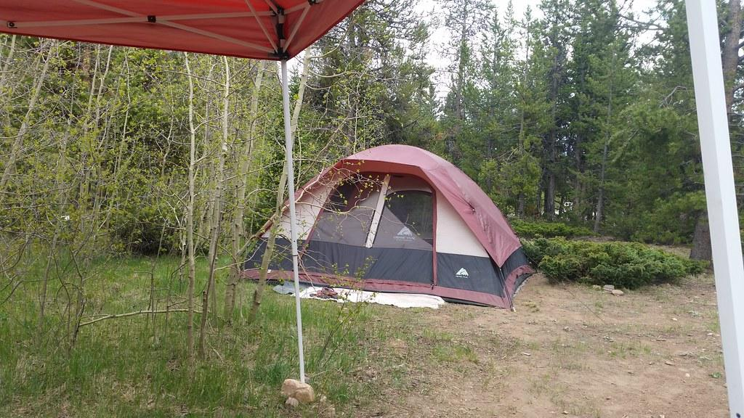
INTRO TO THE PIT COUNT CONTINUED…
As part of the 2023 Sheltered and Unsheltered PIT count, we will survey the number of individuals/households living in Emergency Shelters and Transitional Housing Programs.
We will also be surveying those individuals and families experiencing Unsheltered Homelessness.

Slide 7
2023 PIT Count Surveys
We also use slightly different survey forms from the Sheltered surveys to collect demographic information of people living in Unsheltered Homelessness on the night of the count.
Unsheltered Homelessness: HUD considers individuals and families sleeping in a place not designed for or ordinarily used as a regular sleeping accommodation (e.g., abandoned buildings, train stations, or camping grounds) as “unsheltered” homeless.
HUD would generally consider individuals and families sleeping in a garage, shed, or other location outside of a housing structure, but on the property of a housing structure as “unsheltered” homeless for purposes of the PIT count.
HUD would not consider any individual or family sleeping inside of a housing structure as unsheltered homeless, even if the room inside of that housing structure is not typically used for sleeping (e.g., a kitchen or bathroom).
HUD would still consider persons sleeping in the hallway of an apartment or hotel (i.e., outside of an apartment unit or hotel room) as unsheltered.

Slide 8
2023 PIT Count for RRH and PSH
We utilize a one-page sheet (per program) to “count” the number of individuals living in Rapid Rehousing and Permanent Supportive Housing Programs. We do not require demographic information from these programs.
Rapid Rehousing Definition (RRH): “...Rapid re-housing rapidly connects families and individuals experiencing homelessness to permanent housing through a tailored package of assistance that may include the use of time-limited financial assistance and targeted supportive services.”
Permanent Supportive Housing (PSH): “Permanent Supportive Housing (PSH) is permanent housing in which housing assistance (e.g., long-term leasing or rental assistance) and supportive services are provided to assist households with at least one member (adult or child) with a disability in achieving housing stability. ”
Notes:
You do not need to provide the PIT Count Emergency Shelter/Transitional Housing survey to these program types. We only need a count of the individuals living in the programs on the night of the count. RRH programs also breakdown the household numbers slightly.

Slide 9
Unsheltered Counts
Observational Count Option (Regional Choice)
We ask that any region who opts out of conducting unsheltered surveys, consider taking part in an Observational Count. Speak to Shawn if opting-in to this option.
Observation-only counts produce a head count without verbal or physical interaction between people experiencing unsheltered homelessness and those conducting the PIT count. Thus, observation-based data collection activities must be conducted late at night, when it is reasonable to assume someone is experiencing unsheltered homelessness by virtue of the time and place they are located or sleeping. Typically, observation-only counts are conducted only on the night designated for the PIT count
(i.e., between the hours of 10pm on the night of the count and 6am the next morning), though HUD is providing some flexibility to count people in distinct geographies on consecutive nights, if needed to reduce the number of volunteers needed to conduct the count.
Notes:
HUD has stated that Observational Counts should be conducted without assumption of demographic information, so if you are participating in the observational count you would only be producing a head count based on observation of unsheltered spaces where people experiencing homelessness are living on the night of the count.
Counting on multiple nights would be allowed if there is advanced knowledge that the populations you’re counting do not move between geographic locations regularly.
This is the only slide that goes into detail on observational counts. The trainings in January will provide additional information if your region chooses this option.

Slide 10
Safety
The following website from the CDC provides specific guidance on Unsheltered Homelessness Safety Precautions to utilize for Covid-19: https://www.cdc.gov/coronavirus/2019-ncov/community/homeless-shelters/unsheltered-homelessness.html
Topics Include:
Community coalition-based COVID-19 prevention and response
Communication
Considerations for outreach staff
Considerations for people experiencing unsheltered homelessness
Considerations for encampments
Considerations for a Long-Term Infection Prevention Strategy for People Experiencing Unsheltered Homelessness
Interim Guidance for Homeless Shelters
COVID-19 Readiness Resources

Slide 11
Covid Safety…
Provide personal protective equipment for volunteers (and if possible, extra masks for participants.)
For specific mask and face covering guidance, see: https://www.cdc.gov/coronavirus/2019-ncov/prevent-getting-sick/diy-cloth-face-coverings.html
Design volunteer processes that minimize close contact, for example:
Instruct volunteers to maintain proper social distance from participants and each other based on CDC Guidance.
Develop a process for volunteers to support each other and participants in maintaining safety.
Notes:
Personal Protective Equipment can include Masks, face shields, gloves, etc.

Slide 12
Covid Safety Continued
The following website from the CDC provides specific guidance on Unsheltered Homelessness: https://www.cdc.gov/coronavirus/2019-ncov/community/homeless-shelters/unsheltered-homelessness.html
Topics Include:
Community coalition-based COVID-19 prevention and response
Communication
Considerations for outreach staff
Considerations for people experiencing unsheltered homelessness
Considerations for encampments
COVID-19 Readiness Resources
Notes:
The next group of slides outline Coordinator/Leads roles and responsibilities during the Point-in-Time Counts!

Slide 13
Roles & Responsibilities
Point-in-Time (PIT) Coordinators
Point-in-Time (PIT) Coordinators are individuals who either serve on the Balance of State (BoS) Governing Board, or who volunteer as part of the BoS Homeless Coalition to help organize the Point-in-Time and Housing Inventory Counts for the entire region.

Slide 14
Roles & Responsibilities
Agency Leads and Points of Contacts
Agency Leads and Points of Contact are those who work in agencies participating in the Sheltered Point-in-Time Count and are working with the PIT Coordinators to distribute, monitor survey data collection, and forward any completed paper surveys to the PIT Coordinators.
Electronic surveys will upload automatically.
Agency leads will be the primary contacts of agency staff and volunteers.

Slide 15
Utilize the Wisdom...
Many PIT Coordinators in the Balance of State CoC have done this work for years, and have a lot of experience conducting counts. Feel free to utilize each other if you’re newer to the PIT Counts and have questions about the process!

Slide 16
Responsibilities of Regional PIT Coordinators
Notes:
The following responsibilities are asked of Regional PIT Coordinators and are also often delegated to local leads. These responsibilities help the Housing Inventory Count and Point-in-Time Counts run efficiently.
HUD understands that the Covid-19 pandemic will continue to impact communities differently, so we will outline the general responsibilities and can work together to make sure your community has the capacity and ability to participate in the count!

Slide 17
PIT Coordinator Responsibilities Continued...
Publicize the
Counts
Notes:
Work with regional coalitions and interested parties to publicize the counts in your region. Local libraries, emergency services, hospitals, websites, places where you know people experiencing homelessness will be or those who could be interested in volunteering may find materials.
EMPHASIZE SAFETY PRECAUTIONS AND ANY COVID-RELATED PUBLIC HEALTH COMMUNICATIONS

Slide 18
PIT Coordinator Responsibilities Continued...
Housing Inventory: For the Sheltered Count, review list of Emergency Shelters, Transitional Housing, Rapid Re-housing, and Permanent Supportive Housing Programs
Notes:
CCH will provide the Housing Inventory for the previous year that Coordinators and Leads can review and/or send out to programs to review and provide updates on any changes to programs from previous years.
This also offers a chance for regions to introduce any new ES, TH, RRH, and PSH projects, or remove projects that are no longer in operation. The Housing Inventory includes ALL projects the are considers “ES, TH, RRH, or PSH”, regardless of funding source. It’s important we include as many as we can in order to accurately reflect the number of services being offered to people experiencing homelessness in rural Colorado!

Slide 19
PIT Coordinator Responsibilities Continued...
Identify Leads and work with them to Recruit Volunteers
Notes:
Coordinators utilize their Regional Homeless Coalitions to identify Leads depending on the size of your count and region. Once identified it’s best to work with them to recruit volunteers, post advertising materials, engage with local businesses, make sure all regional ES, TH, RRH, and PSH programs are participating, etc. Leads may also work with their regional coalitions to expand the count.
Transparency around safety during the Covid-19 pandemic is essential.

Slide 20
Who are the Volunteers?
Volunteers often represent service or community organizations, government entities, local police (if there is a good relationship with the community experiencing homelessness), emergency responders, college students, volunteer groups, churches & faith groups, people currently or formerly experiencing homelessness, etc...
Notes:
Consider utilizing Leads to recruit volunteers, or utilize volunteers to build your base. It’s always a good idea to utilize people currently experiencing homelessness to assist with counts. They have a unique understanding of the situation and especially during unsheltered counts may be able to offer invaluable information about where others who are experiencing homelessness may be.
Covid-19 introduces unique challenges, especially due to increased rates of infections for those in groups that are at higher risk of contracting the virus such as people over the age of 60, People of Color, people with disabilities, immunocompromised people, etc.

Slide 21
PIT Coordinator Responsibilities Continued...
Train Surveyors / Volunteers
Notes:
Utilize regional knowledge and materials provided to train surveyors. In January we will provide a webinar early in the month focused on surveys and safety that will be available online for you to provide to volunteers surveying, along with all of the materials that were included with the email you receive this powerpoint in; which you can modify for your regional coalitions and make “fit” for your needs.
Some regions will still have a reduced volunteer force due to the Covid-19 pandemic. This is understood to be a consequence of Covid-19 though we hope precautions will allow for survey collection. Make sure to work with your local Public Health organization on best practices for conducting the count if that is what your region has chosen to do. Please communicate all decisions with Shawn shayes@coloradocoalition.org.

Slide 22
PIT Coordinator Responsibilities Continued...
Distribute Survey Forms in January along with Trainings Materials depending on your regional needs
Notes:
With the exception of the CCH ES/TH and Unsheltered Survey Forms, most other training materials can be modified by regions to fit with your local needs. (Scripts, Fact Sheets, etc.)

Slide 23
PIT Coordinator Responsibilities Continued...
Please use only the survey forms provided by CCH and do not modify the forms in any way.
Notes:
We may have forms pre-populated with program names for the Sheltered Counts, and the ability to add electronically for other forms. However, do not add or modify questions on the Survey form itself. You may choose to include addendums or your own survey forms, similarly to the Youth Supplemental Survey, which we’ll discuss later in this PowerPoint..

Slide 24
Responsibilities of PIT Coordinators, getting close to being done...
Meet with Surveyors close to the count. Consider virtual meetings due to the pandemic.
Can you provide food virtually? No seriously, can you?
Notes:
This will help Surveyors/Volunteers know the process closer to the count and keep them engaged! We will provide a survey-specific trainings in January for the BoS PIT Count Surveys and Youth Supplemental Survey. These will be recorded and available for regions to send to volunteers.
Again, utilize those in your region who have been doing this for years. Also, reach out to other Coordinators across the BoS if you’re new to the count or are a region that hasn’t participated in certain parts of the count in the past.

Slide 25
Connection to other services
Make sure to encourage agencies to have information about additional service on hand should should they exist in your community. The PIT Coordinator and/or Lead should provide these resources.
Referrals can include, but are not limited to:
Food Banks
Daytime Warming Spaces
Other Community Shelters
Domestic Violence Survivor Resources
Emergency Services
Services for other special populations like youth, veterans, elderly/disabled, etc.
Notes:
This may include connecting survey participants to another agency. Because this year is a sheltered count only, the focus is on those already in programming. However, there may be need for additional services so it is always a good idea to have information on hand.
Additionally, if you are deciding to participate in any type of Unsheltered Count or Youth Supplemental Survey, these would be necessary.

Slide 26
Safety. Privacy. Security.
Notes:
During a sheltered count the safety, privacy, and security precautions would generally follow those of the agency where the count is being held. Make sure to work with the agency and community leads to ensure measures meet standards that will allow volunteers/surveyors and participants to keep personal and professional boundaries as generally recognized in HUD funded and other Human Services agencies. More to come on that.

Slide 27
Data Collection Related Safety
Encourage Programs, Leads and Volunteers to maintain personal safety and honor client safety.
Some things to focus on:
Does the place where survey is being conducted offer a clear exit route if inside, or is it visible to other surveyors if outside?
Will other surveyors, agency staff, etc. have easy access to the space in case of emergency? Plan ahead with agency leads.
Encourage surveyors to trust their instincts. If something feels off, reach out to your agency Lead or another trained employee for direction.
Surveyors and participants should observe the agencies safety precautions if inside.

Slide 28
Privacy, Security, Safety & Script
Please encourage volunteers to familiarize themselves with the 2023 Sheltered and Unsheltered PIT Instructions and Script, which helps:
Identify a private, safe space to ask survey questions an/or make sure participants are comfortable in the space you’re in.
Informs participants about Covid-19 Safety and Precautions.
Inform participants about the nature of the survey questions.
Inform participants about how data is collected and how their information is used/protected.
Reminds surveyors to answer EVERY applicable question on the surveys, as long as the client does not refuse to answer.
Notes:
Please work with agency leads to speak with volunteers in advance in order to make sure safety of the surveyors and the survey participants is respected.

Slide 29
Refusals
Please remember to remind surveyors; Individuals and Families are free to refuse to answer any question on the survey, but typically do so because they are either not understanding what the surveyor is asking or may not know enough about how we de-identify survey answers.
We want to avoid refusals as much as possible! Surveyor trainings in January will offer advice on how to avoid this.
As leads, be available to help a surveyor explain to participants the reasons questions are being asked and how information is de-duplicated. This can help the participant feel more comfortable answering and also help the surveyor become more comfortable working through the issues that come up themselves.
Sometimes clients may not understand the question, so you or the surveyor may need to break the question down in more concrete ways.
Notes:
We will discuss this further when breaking down the surveys.

Slide 30
IMPORTANT!
This can’t be emphasized enough for surveyors. It’s extremely important to answer EVERY applicable question on the survey forms LEGIBLY.
Incomplete or hard to read survey forms can not be used.
Please regularly remind surveyors of this!
Notes:
Surveyors should be directed to complete a few surveys and then bring to the leads in order to make sure the forms are being completed correctly. This will hopefully help address any issues ASAP and perhaps correct any problems.
As noted on the survey form, mark “R” legibly if there are any refusals so that we know the question was not just skipped.

Slide 31
Sheltered Count Surveys
The Surveys will be collecting similar information to 2021 and 2022, with a few updates to the demographic questions. (Age related)

Slide 32
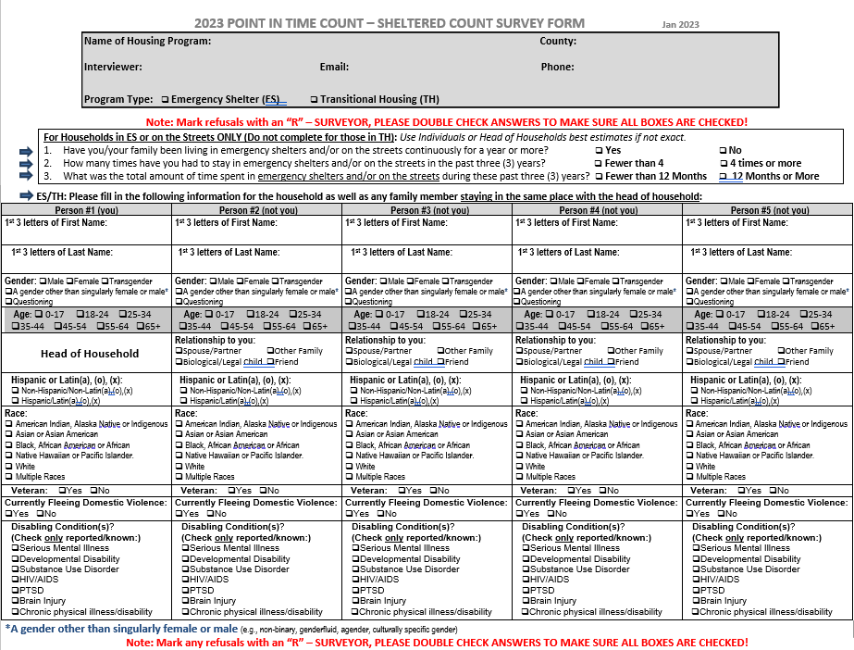

Slide 33
Unsheltered Count Surveys
The Surveys will be collecting similar information to 2021 and 2022, with a few updates to the demographic questions. (Age related)

Slide 34
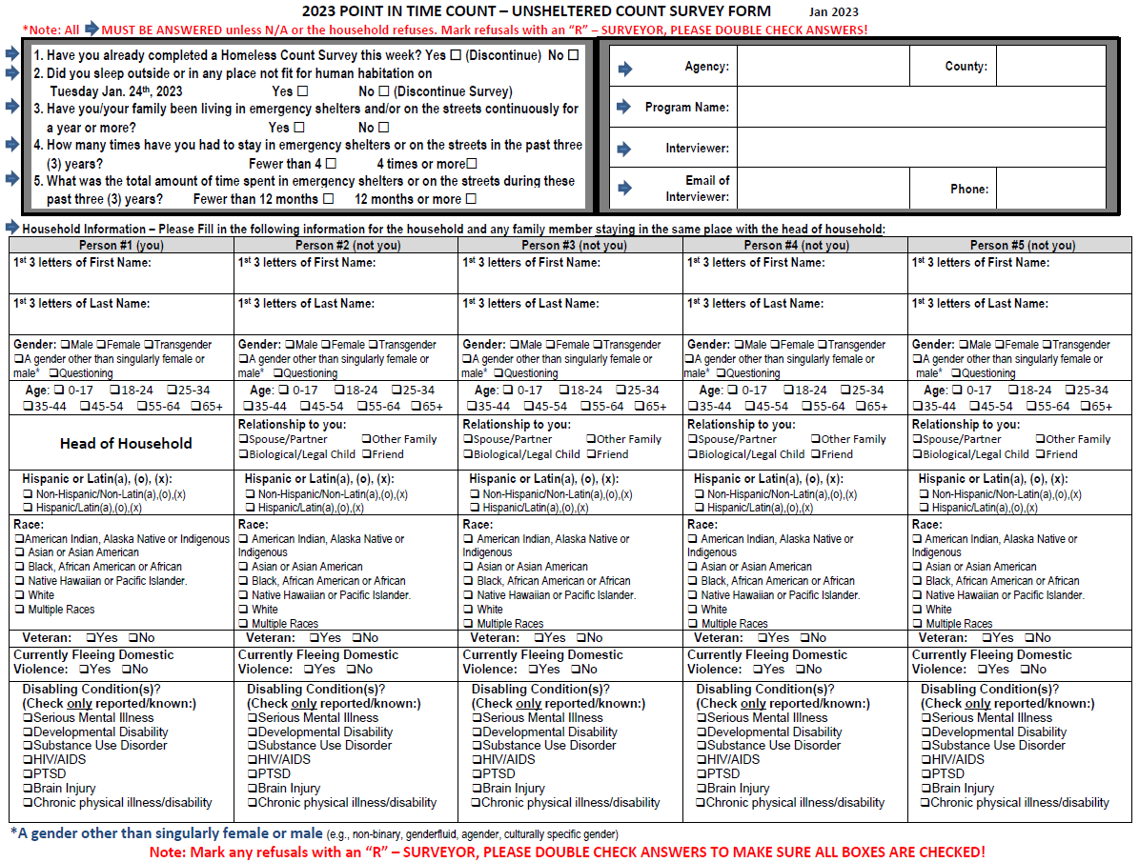

Slide 35
Permanent Supportive Housing (PSH) and Rapid Re-Housing (RRH) Survey Forms
PSH and RRH Forms collect total number of persons housed on the night of Tuesday January 24th, 2023, in each program type.
Notes:
Coordinators will collect forms from agencies in their region and organize them by program type. Once organized, please attach cover sheets provided by CCH and mail along with the ES and TH forms as described at the end of the training. The cover sheets help to keep track of the programs and numbers of surveys so we can better organize for our PIT Consultant. They are the organization who enters the survey data, de-duplicates surveys, and compiles the information to draft the final PIT Report.

Slide 36
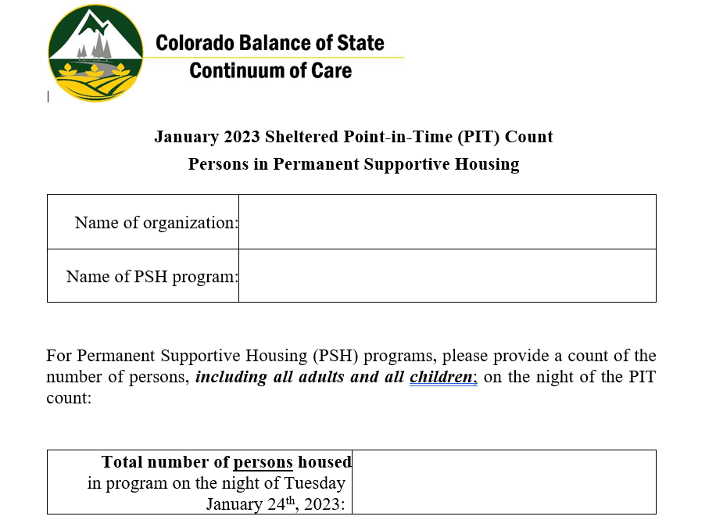
Permanent Supportive Housing (PSH)
Survey Form
Notes:
Continue to next slide.

Slide 37
Permanent Supportive Housing (PSH) Forms
Information Collected:
Name of Organization - Organization that operates the PSH and/or RRH Program. (Example: Grand Valley Catholic Outreach “GVCO”)
Name of PSH Program - There should be a separate PSH/RRH form for each program. (For example: St. Benedict PSH, St. Martin PSH would each have a separate form even though they are operated under Grand Valley Catholic Outreach in Grand Junction.)
Total Count of Individuals in Program on the Night of January 24th, 2023
Total number of persons who stayed in the PSH program on the night of Tuesday January 24th, 2023

Slide 38
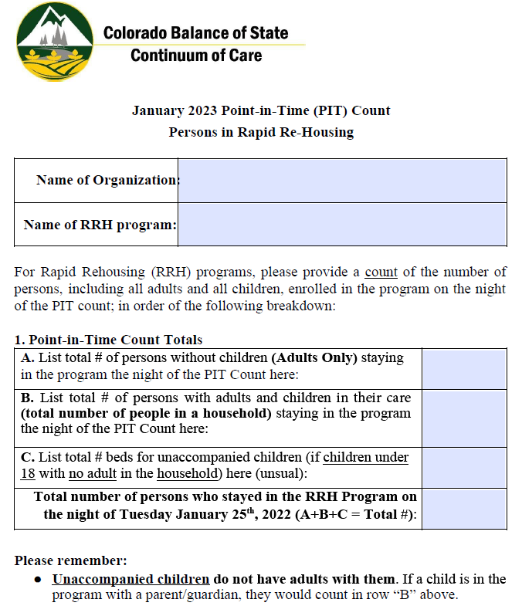
Rapid Rehousing (RRH)
Survey Form

Slide 39
Rapid Re-Housing (RRH) Survey Forms
Information Collected:
In addition to the same organization and program information we collect from the PSH PIT Forms, to better understand the breakdown in your RRH programs we will collect:
Household Breakdown & Total Persons in Program on Night of Count
List total # of persons without children (Adults Only) staying in the program the night of the PIT Count here:
List total # of persons with adults and children in their care (total number of people in a household) staying in the program the night of the PIT Count here:
List total # beds for unaccompanied children (if children under 18 with no adult in the household ) here (unusual):
Total number of persons who stayed in the program on the night of Tuesday January 24th, 2023

Slide 40
Permanent Supportive Housing (PSH) and Rapid Re-Housing Survey Forms

Slide 41
Electronic Surveys
In 2023 we are asking providers to complete Electronic Surveys for any Emergency Shelter or Transitional Housing programs whenever possible.
This requires the surveyors to be connected to the internet and go to a website that holds the survey questions.
Surveyors will need to use computers, tablets and/or cell phones.
The surveys would all ask the same questions in the 2023 PIT Sheltered Count Survey Form and upload to our consultant automatically.
Always keep paper surveys on hand in case of technology issues!
Questions? Email shayes@coloradocoalition.org.
Complete the poll so we know who will be participating in E-Surveys!
Trainings for the Electronic ES and TH PIT Survey Option will be included in the Surveyor Trainings in January!

Slide 42
Poll Call!
Electronic Surveys, HMIS, Youth Supplemental Survey, Youth Unsheltered PIT Count
TAKE OUR POLL!
We will have an Electronic Survey Option and the ability to pull Point-in-Time data directly from the Homeless Management Information System. Additional training and steps are required for these.
Additionally, the Youth Supplemental Survey and Unsheltered Count are essential in 2023 to ask additional questions of unaccompanied youth between the ages of 15 and 24 who are experiencing homelessness. Please take the poll to let us know you’ll be able to participate!
COMPLETE THIS POLL! (Link in Chat): https://forms.gle/Mx6HhTZ9AiwP1aR17
Notes:
Assists in understanding this underserved population. Assists with funding sources like the Youth Homelessness Demonstration Program (YHDP).

Slide 43
You made it!
Survey Collection

Slide 44
Paper Survey Collection
Steps for Collection of 2023 BoS Sheltered Count Paper Surveys:
Collect all of the survey forms from your housing programs, volunteers and leads.
Sort them by Type:
ES & TH surveys (and if participating.. for Youth Supplemental Surveys attach to the matching BoS PIT Survey… DO NOT SEPARATE!)
RRH & PSH count forms (If participating, attach YSS forms to these as well. There will be no corresponding BoS PIT Survey.)
Add CCH cover sheets. (I will be providing these with the surveys.)
Notes:
Electronic Surveys will upload automatically to our PIT Consultant OMNI. Please make sure to provide cover sheets to agencies participating in the Electronic count so they can document the surveys they sent in.
Coordinators will collect paper forms from agencies in their region and organize them by program type (Unsheltered, ES & TH Surveys, RRH & PSH Count forms. If participating: YSS attached to their corresponding Survey). Once organized, please attach cover sheets provided by CCH and mail along with the forms as described at the end of the training.
The cover sheets help to keep track of the programs and numbers of surveys so we can better organize for our PIT Consultant, Omni. They are the organization who enters the survey data, de-duplicates surveys, and compiles the information to draft the final PIT Report.

Slide 45
Paper Survey Collection
Steps for Collection of 2023 BoS Sheltered Count Paper Surveys:
Agencies/Orgs/Volunteers should be instructed to turn in all surveys to you ASAP or by EOB Wednesday February 1st, 2023.
This gives agencies a week to collect surveys and time to organize and send.
Please complete cover letters and turn all surveys into me ASAP or by EOB Friday February 10th, 2023.

Slide 46
Survey Collection
Steps for Collection of 2023 BoS Sheltered Count Surveys, Continued:
Either scan surveys and email them (including YSS) to me securely shayes@coloradocoalition.org (preferred), fax them to my attention (303-298-1021), or mail them to me.
Colorado Coalition for the Homeless:
ATTN: Shawn Hayes
2111 Champa Street
Denver, CO 80205
Make sure always to keep copies for your record! This is especially important in case any surveys are lost in scanning or mailing!

Slide 47
Make Copies!
4. Again, don’t forget to save copies of all survey forms for your local CoC planning group!
Notes:
Also, it would important to have copies made in case of mailing issues. The Collaborative Applicant (CCH) does not keep copies of the survey forms.

Slide 48
Questions or Considerations?

Slide 49
Contact Information
For questions about the 2023 Balance of State Continuum of Care Point in Time Sheltered and Unsheltered Count Contact:
Shawn Hayes
Balance of State Continuum of Care Coordinator
Colorado Coalition for the Homeless
2111 Champa Street
Denver, CO 80205
Main: 303-293-2217
Direct: 303-312-9651
Email: shayes@coloradocoalition.org (preferred)
Website:
Main: https://www.coloradocoalition.org/COBoSCoC
PIT Count Specific: https://www.coloradocoalition.org/BoSCoCPITHIC
Notes:
Also, if you’re working, or are interested in working with the Rural Collaborative for Homeless Youth to Conduct the Youth Homelessness Unsheltered Count in your county and want to get connected, Click to the next slide!

Slide 50
Youth YSS & Optional Unsheltered Count Contact Information
For questions about the Youth Supplemental Survey & Unsheltered Count Contact:
To help get an accurate and detailed count of youth experiencing homelessness in your county, contact:
Brittany Wade
Division of Housing (DOH)
Department of Local Local Affairs (DOLA)
Office of Homeless Initiatives (OHS) Office of Homeless Youth Services (OHYS)
Cell: 720.670.4633 Email: brittany.wade@state.co.us
Website: https://www.colorado.gov/pacific/dola/office-homeless-youth-services-ohys
Click to the next slide for information on the optional youth unsheltered count.
Kippi Clausen
Unfolding Directions, LLC
Phone: 303-521-8968
Email: kippi@unfoldingdirections.com
Website: www.unfoldingdirections.com
Notes:
The Rural Collaborative for Homeless Youth is happy to assist you in finding volunteers to assist with the Unsheltered Counts!

Slide 51
Additional Resource Information
Local Emergency
Managers
Find your local
public health agency
The following is a list of County-level emergency management websites, telephone (office and 24 hour), emails and sms/text alert systems in Colorado.
To best stay informed before, during and after a disaster you are encouraged to monitor a number of information sources, including systems such as local emergency services websites, warning sirens, SMS or text alert systems, local/national media outlets, and local government sources.
https://www.colorado.gov/pacific/dhsem/local-emergency-managers
Public health agencies provide a variety of services, ranging from Community and Behavioral Health to Environmental Quality.
They can also assist communities in following best practices when conducting PIT Counts.
https://cdphe.colorado.gov/public-information/find-your-local-public-health-agency

Slide 52
Thank you for all you do to help people experiencing homelessness in Colorado’s rural and non-metro communities!
End of Presentation

