Slide 1
Colorado Coalition for the Homeless HUD Notice of Funding Available 2022
Unsheltered and Rural Set Aside + Annual NOFO
Friday, August 12th, 2022
A recording of this meeting will be posted on our CCH BoS website with an FAQ for Review.

Slide 2
Overview
Introductions and Welcome
Lead Agency/Collaborative Applicant Work/TA Consultant
Regular NOFO and Special NOFO Overview
Timeline
Q&A
Recommendations
Important Dates!

Slide 3
CoC Consolidated Application
Project Ranking
Technical Assistance and Support
Strategic Planning
CCH Project Applications (PSH/RRH, TH, Planning, HMIS, CES)
Department of Housing and Urban Development (HUD)
Balance of State Continuum of Care
10 Regional Coalitions (You!)
Balance of State Governing Board
Lead Agency/Collaborative Applicant & TA Consultant (CCH)
Homeless Management Information System (HMIS) Lead Agency (CCH)
Balance of State Committees

Slide 4
Overview of HUD Funding
The Department of Housing and Urban Development (HUD) has released 2 NOFOs.
Approximately $322,000,000 is available through the Special Unsheltered Set Aside and Rural Set Aside NOFO:
$54,500,000 for the Rural Set Aside
$267,500,000 for the Unsheltered Homelessness Set Aside
Approximately $2,794,000,000 is available through the Annual FY 2022 CoC Competition NOFO or "Regular" NOFO:
New Funding for BoS:
$3,251,192 is set aside for new projects that address unsheltered homelessness for CO Balance of State (BoS) communities.
$3,326,789 is set aside specifically for projects in Colorado's rural communities
Both funding types focus on people with the highest service needs. The CO BoS is eligible to apply for both types of funding, totaling $6,576,981 in potential new dollars. This Supplemental Competition is separate from the FY2022 CoC Program Competition or what we call the "Regular" or "Annual" CoC NOFO Competition.

Slide 5
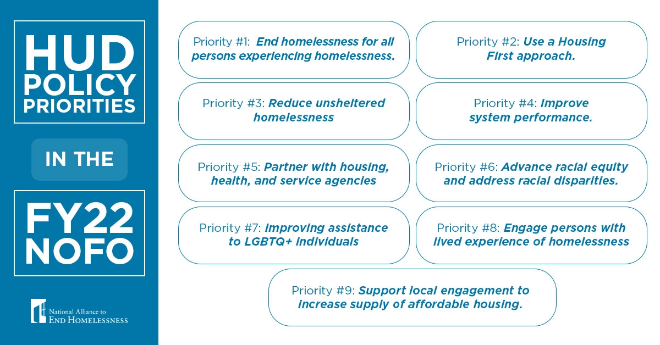
HUD Strategies to Consider for BoS CoC as a whole and the 10 Regional Coalitions/CoC's

Slide 6
What is HUD looking for?
HUD will review each program application and even if the CoC recommends a program for funding, HUD may reject it.
Please ensure the following:
1. all proposed program participants will be eligible for the program component type selected,
2. the information provided in the project application and proposed activities are eligible and consistent with program requirements in the Rule;
3. each project narrative is fully responsive to the question being asked and that it meets all the criteria for that question as required by this NOFO;
4. the data provided in various parts of the project application are consistent; and
5. all required attachments correspond to the list of attachments in e-snaps that must contain accurate and complete information that are dated between June 22, 2022 and October 20, 2022.

Slide 7
What is HUD Looking For? (The CoC's Strategic Plan)
Specifically, HUD is seeking projects that:
End homelessness for all persons experiencing homelessness;
Place emphasis on racial equity and anti-discrimination polices for LGTBQ+ individuals;
Use a Housing First approach;
Reduce unsheltered homelessness and reduce the criminalization of homelessness;
Improve system performance;
Partner with housing agencies to leverage access to mainstream housing programs;
Partner with health agencies to coordinate health and supportive services, including to prevent and respond to future infectious disease outbreaks;
Advance racial equity and addressing racial disparities in homelessness;
Engage people with lived experience of homelessness in decision-making; and
Support local engagement to increase the supply of affordable housing.
https://www.hud.gov/press/press_releases_media_advisories/HUD_No_22_140

Slide 8
What is HUD Looking For? (The CoC's Strategic Plan—Unsheltered/Rural)
Leveraging Housing
Development of new units and creation of housing opportunities
Landlord Recruitment
Leveraging Healthcare Resources
Current Strategy to Identify, Shelter, and House Individuals and Families Experiencing Unsheltered Homelessness
Current street outreach strategy
Current strategy to provide immediate access to low-barrier permanent housing
Identify and Prioritize Households Experiencing or with Histories of Unsheltered Homelessness.
Involving Individuals with Lived Experience of Homelessness in Decision Making
Promoting Racial Equity in Homelessness Response
Improving Assistance to LGBTQIAA2S+ (Lesbian, Gay, Bisexual, Transgender, Queer/Questioning, Intersex, Asexual, Androgynous, 2-Spirit, and other Individuals on the spectrums of sexuality and gender)
Supporting Underserved Communities and Supporting Equitable Community Development

Slide 9
Special Supplemental NOFO
Special Supplemental NOFO
Rural Set Aside
Annual CoC Competition NOFO
Unsheltered Set Aside

Slide 10
Special Supplemental NOFOs: Project Requirements for Both
All projects funded under this Special NOFO must adopt and follow a Housing First approach
All projects must pass eligibility and quality thresholds outlined in the NOFO to be considered for funding
All applicants must demonstrate, in their project application, how they are consistent with the CoC’s Plan for Serving Individuals and Families Experiencing Homelessness with Severe Service Needs
Advance Equity

Slide 11
Process and Scoring for both Special NOFOs
Unsheltered Homelessness Set Aside
CoC Consolidated Applications will be assessed on a 100- point scale
CoCs must receive at least 50 points to be considered for any funding under this Competition
Bonus points were available based on the 2019 PIT unsheltered count being greater than 1,000
Rural Set Aside
• CoC Consolidated Applications will be assessed on an 89- point scale • CoCs must receive at least 44.5 points to be considered for any funding under this Competition

Slide 12
Process and Scoring for both Special NOFOs (cont.)
The Consolidated Application is made up of 4 scoring sections with several sub-questions:
1. Project Capacity, Review, and Ranking (4 points)– statutory selection criteria – all parts required to apply for funding under the Rural Set Aside
2. System Performance (18 points) – statutory selection criteria – all parts required to apply for funding under the Rural Set Aside
3. CoC Coordinated and Engagement (8 points) – statutory selection criteria – all parts required to apply for funding under the Rural Set Aside
4. CoC Plan for Serving Individuals and Families Experiencing Homelessness with Severe Service Needs (70 points for Unsheltered Homelessness Set Aside and 59 points for Rural Set Aside) - attached narrative – only some parts required to apply for funding under the Rural Set Aside

Slide 13
Who can apply for the Special Supplemental NOFO Funds?
CoC and non-CoC Funded agencies are welcomed and encouraged to apply!
Eligible Project Applicants (24 CFR 578.15, 24 CFR 5.100). Eligible project applicants for this Special NOFO are found at 24 CFR 578.15 and the Act and include nonprofit organizations (includes faith-based), states, local governments, instrumentalities of state and local governments, Indian Tribes and TDHEs (as defined in section 4 of the Native American Housing and Self-Determination Act of 1996 (25 U.S.C. 4103). Public housing agencies, as such term is defined in 24 CFR 5.100, are eligible without limitation or exclusion. For-profit entities are ineligible to apply for grants or to be subrecipients of grant funds.
Please note that current CoC or ESG-funded projects are not eligible to apply for additional funds for their projects under this NOFO, but CoC and ESG-funded agencies can apply for NEW projects under this NOFO. See bottom of page 19 of the Special NOFO for additional eligible project applicant information.
Please reach out with any specific questions on your project.

Slide 14
Supplemental NOFO: Unsheltered Specifically
Eligible Project Types
Permanent Supportive Housing (PSH), Permanent Housing-Rapid Re-housing (PH-RRH), Supportive Service Only (SSO), Joint Transitional Housing Permanent Housing Rapid Rehousing (TH-PH RRH), SSO-Coordinated Entry, SSO Street Outreach
Lead Agency Only: Homeless Management Information System (HMIS), Continuum of Care (CoC) Planning
Grant terms will be 3-years

Slide 15
Rural Set Aside
Eligible Project Types
PSH and/or PSH-RRH, SSO TH-PH RRH, (SSO)-Coordinated Entry, SSO Street Outreach, and additionally Acquisition, New construction, and/or Rehabilitation.
Lead Agency Only: HMIS
Grant term will be 3 years
For the Rural Set Aside, eligible activities are
Those normally eligible under the CoC Program
Those listed in Section IV.B.3.e(2)(b) of the Special NOFO
Staff and overhead costs directly related to carrying out the eligible costs of Section IV.B.3.e(2)(b) of the Special NOFO
All costs must be part of an SSO, PH, or Joint TH and PH:RRH Component project

Slide 16
Rural Set Aside: New Fund Opportunities—The Details
Up to 6 months of rent or utility arrears after 2 months of nonpayment of rent or utilities. Funds may be used to pay:
Rent arrear payments up to 6 months of program participants residing in permanent housing • Utility arrear payments up to 6 months of program participants residing in permanent housing
Short-term emergency lodging in motels or shelters, either directly or through voucher. Eligible costs include: • Lodging costs in motels or hotels for program participants
Pro-rata share of sheltering program participants in existing shelters so long as the costs are actual costs of creating new and temporary beds in emergency shelters and not to permanently increase the capacity of the shelter *No funds may be used to shelter program participants in existing shelter beds
Repairs, up to $10,000 per structure, that are necessary to make housing habitable to be used for transitional or permanent housing. The types of repairs that could be eligible include:
Insulation • Window repair • Door repair • Roof repair • The total cost of repairs may not exceed $10,000 per structure.
Emergency food and clothing assistance. Eligible costs are:
Providing meals or groceries to program participants • Providing clothing to program participants

Slide 17
Rural Set Aside: New Fund Opportunities—The Details Cont.
Costs associated with making use of Federal Inventory property programs to house individuals and families experiencing homelessness. Eligible costs are: • Preparing and submitting applications to obtain ownership of the real property • Transfer taxes • Recording fees • Closing costs • Building permit and zoning fees
Costs associated with making use of Federal Inventory property programs to house individuals and families experiencing homelessness. Eligible costs are (cont.): • Attorney’s fees • Rehabilitation of buildings and structures on the property • Sewer and utility hook-up fees and deposits and bringing lines to the property • Wells • Septic systems • Improving access to the real property from public roads
Capacity building activities. These are activities that maintain or improve the skills of recipients and subrecipients. Eligible capacity building activities include: • Employee education • Job training • Staff retention activities • Continuing education opportunities • Cross training within an organization • Staff training and professional licensing or certification • Other professional development activities • An applicant may apply for up to 20% of funds requested as part of the project

Slide 18
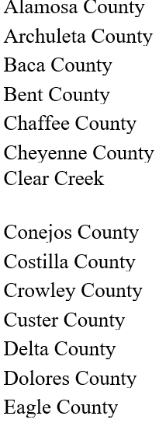
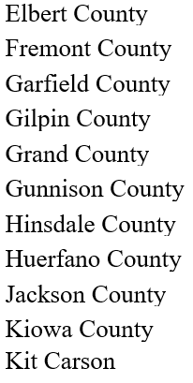
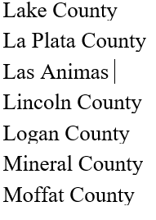
Rural Set Aside: Who can apply?
A complete list can be found at HUD's website

Slide 19
How do I apply for the Special Supplemental NOFO Funds?
Please visit the “CoC Program Applications and Grants Management System'' on the HUD Exchange and follow the e-snaps toolkit instructions.
e-snaps Navigation and Application Resources

Slide 20
The Annual Fiscal Year (FY) 2022 Continuum of Care Competition "Regular CoC NOFO"
The CoC Program Registration opened on March 4, 2022, and closed on April 7, 2022. The CoC Program Review Step opened on May 31, 2022, and closed on June 3, 2022.
The FY 2022 CoC Program Competition opened on August 1, 2022, and closes on Friday, September 30, 2022.

Slide 21
The Annual Fiscal Year (FY) 2022 Continuum of Care Competition "Regular CoC NOFO"
Returning project applicants (who did not go through a consolidation): May choose to import FY 2021 renewal project application responses; however, this must be requested during your registration of the Renewal Funding Opportunity in e-snaps and is only available if you submitted a project application in the FY 2021 CoC Program Competition. Imported responses must be carefully reviewed to ensure accuracy.
Projects renewing for the first time: Who were previously awarded prior to the FY 2021 CoC Program Competition must complete the entire renewal project application.
New project applications: Must be completed in full and in accordance with the new project application components permitted in this year’s Competition.

Slide 22
The Annual Fiscal Year (FY) 2022 Continuum of Care Competition "Regular CoC NOFO"
DV Bonus funding is not limited to DV providers. You can apply for funding as long as you are supporting survivors of domestic violence as defined by HUD.
DV Bonus funding is not subject to limitations of new project concerns in the Project Ranking process (more to come on that in the Project Ranking Discussion)

Slide 23
The Annual Fiscal Year (FY) 2022 Continuum of Care Competition
The Dept. of Housing and Urban Development (HUD) has officially posted the Notice of Funding Opportunity (NOFO) for the Fiscal Year (FY) 2022 Continuum of Care Competition on Grants.gov.
The application questions for the Special NOFO and CoC NOFO are statutory and closely aligned
Strategy-wise, all projects should be aligned

Slide 24
Project Ranking: What is it? What is new this year?
Project Ranking is a mandated part of a NOFO process and requires CoC's to rate and rank New and Renewal CoC projects using objective criterion.
Projects must be ranked regardless of how they perform, with certain exceptions (example: CoC Planning)
Projects are funded based on overall CoC score, funded from the highest ranked CoC in the country to the lowest ranked CoC in the country.
The CoC NOFO's show how CoC's are scored in the CoC competition.
The CO BoS CoC generally falls in the middle of CoC's scored across the country.
This is why it's important to work with your regions Governing Board Member to answer questions during the NOFO scoring process.
Tier 1 Projects are generally funded. Tier 2 projects risk being defunded.
The BoS CoC Governing Board has generally voted to rank New Projects in Tier 2 in order to avoid risking existing projects, which do not perform poorly but must be ranked in the competition. Instead we are always attempting to increase our overall CoC score so we can be awarded new projects.
We need everyone's help to increase our CoC's overall score!
The Special NOFO offers an unprecedented opportunity to apply for new funding without risking any existing projects and bring a lot of new funding into the state to serve people experiencing homelessness!

Slide 25
Timelines
SUPPLEMENTAL UNSHELTERED/RURAL NOFOs
June 22, 2022 2022 | Release date: CoC Supplemental NOFO to Address Unsheltered & Rural Homelessness release and e-SNAPS available.
Tuesday, September 20, 2022 | All project applications must be submitted to e-snaps for review and ranking by the Project Ranking Committee.
October 5, 2022 | CoC notifies, in writing, all project applications who submitted their project applications to the CoC by the CoC established deadline whether their projection application(s) will be accepted and ranked on the CoC Priority Listing, rejected, or reduced by the CoC.
October 18, 2022 |CoC posts on our website all parts of the Special NOFO Consolidated Application, including the CoC Application, the CoC Application attachments, and the CoC Priority Listing, and notifies key community members and stakeholders that the CoC Consolidated Application is available.
Thursday, October 20, 2022 | no later than 8:00 PM Eastern Time – Response to CoC NOFO Submission Deadline
Annual FY 2022 CoC Competition NOFO
August 1, 2022| Release date: CoC Annual NOFO Award release and e-SNAPS available.
September 15, 2022 | All project applications must be submitted to e-snaps for review and ranking by the Project Ranking Committee.
September 22, 2022 | CoC notifies, in writing, all project applications who submitted their project applications to the CoC by the CoC established deadline whether their projection application(s) will be accepted and ranked on the CoC Priority Listing, rejected, or reduced by the CoC.
September 28, 2022 |CoC posts on our website all parts of the NOFO Consolidated Application, including the CoC Application, the CoC Application attachments, and the CoC Priority Listing, and notifies key community members and stakeholders that the CoC Consolidated Application is available.
September 30, 2022 | no later than 8:00 PM Eastern Time – Response to CoC NOFO Submission Deadline

Slide 26
Which one should I apply for?

Slide 27
What's next?
How can I join my regional CoC?
Get Involved - CO BoS CoC
Updates and Announcements
BoS CoC Updates and Announcements Website including regular content updates like this Q&A and follow-up FAQ.
How can I dialogue further about the BoS HUD NOFO?
NOFO Committee
Project Ranking
Reach out to Shawn Hayes: shayes@coloradocoalition.org
August 17th | 12-1 PM | National Alliance to End Homelessness Webinar—What you need to know about the 2022 CoC Program Competition
August 19th 2022 | 8:30am-10am | CCH Education & Advocacy Department Presentation on ARPA Funds |calendar invitation to follow

Slide 28
Resource Links: Unsheltered & Rural Set Aside NOFOs
Special NOFO to Address Unsheltered and Rural Homelessness -
Webinar Slides
Chat log
Recording
Transcript
Special NOFO to Address Rural Homelessness
Webinar Slides
Chat log
Recording
Transcript
For more comprehensive information on the Special NOFO(s), please review this fact sheet put together by the National Alliance to End Homelessness.

Slide 29
Resource Links: HUD Annual CoC NOFO
Continuum of Care Program Competition page of HUD’s website

Slide 30
Questions?
HUD CONTACT INFORMATION
Feel free to email questions to:
SpecialCoCNOFO@hud.gov for general questions regarding the Unsheltered/Rural Supplemental NOFOs
CoCNOFO@hud.gov for general questions regarding the Annual CoC NOFO
e-snaps@hud.gov - for general questions related to e-snaps functionality (e.g., password lockout, access to user’s application account, updating Applicant Profile)
CCH CONTACT INFORMATION
Please contact Deanne Witzke dwitzke@coloradocoalition.org and Mark Miller mmiller@coloradocoalition.org and one of us will reply to your question regarding the NOFOs.
For HMIS specific questions, please contact Denny Wetmore dwetmore@coloradocoalition.org

Slide 31
Q&A

